Slide 1
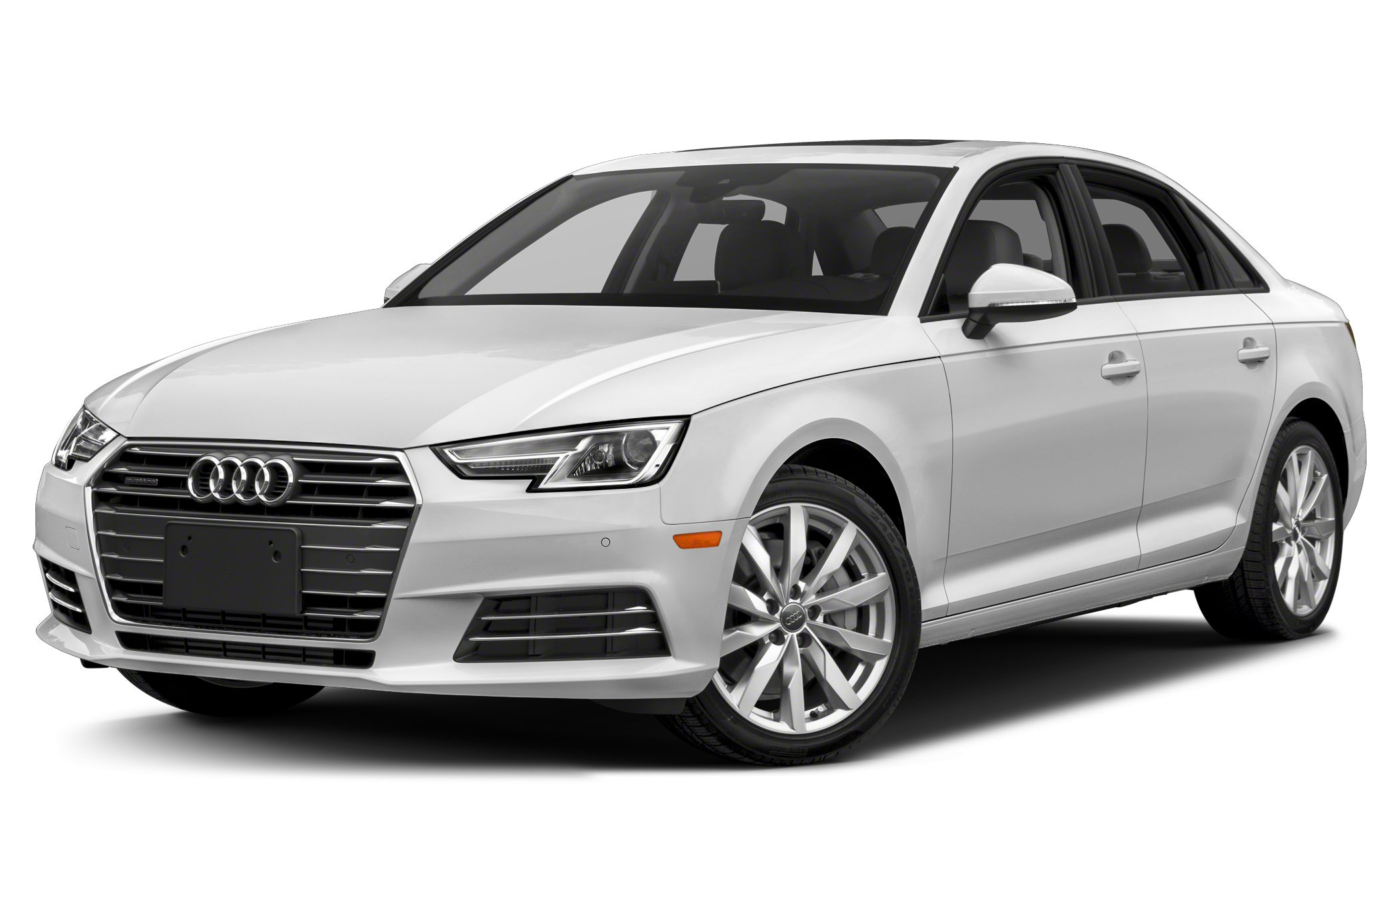
Used OEM Audi Parts
Notes:
Audi is a German automobile manufacturer that designs, engineers, produces, markets and distributes luxury vehicles. Audi is a member of the Volkswagen Group and has its roots at Ingolstadt, Bavaria, Germany. Audi-branded vehicles are produced in nine production facilities worldwide.
You can quickly check the cost, durability, and availability of the used Audi parts. Our expert sales staff is always on the standby to help you buy used Audi parts that will benefit your vehicle and your pocket at large. We are always here to take your order and in case, which is rare, any part is unavailable, we will go to great lengths to get them in stock for you.

Slide 2
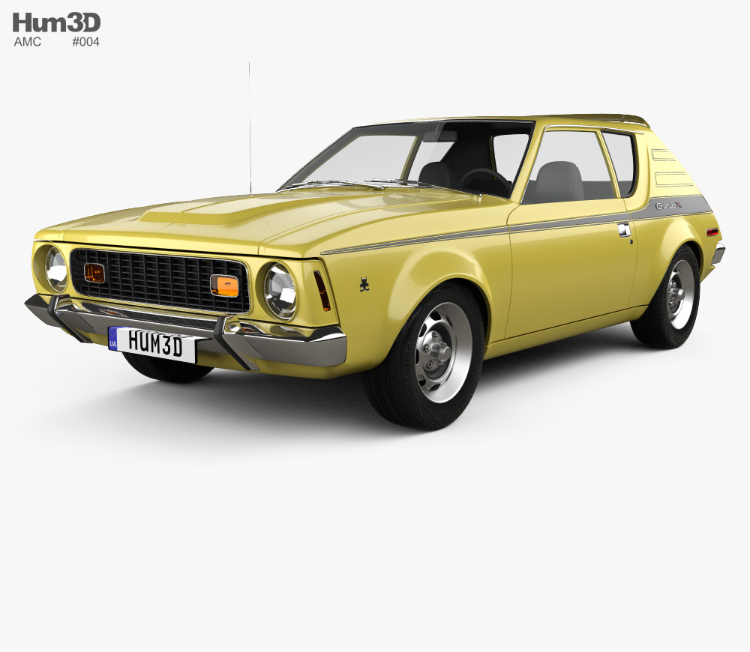
Used OEM AMC Parts
Notes:
American Motors Corporation (AMC) was an American automobile company formed by the 1954 merger of Nash-Kelvinator Corporation and Hudson Motor Car Company. At the time, it was the largest corporate merger in U.S. history.
The role of the AMC used parts online such as the abs control module is to make sure that the antilock brake system of your car works properly. It also transfers the information from the sensors and the hydraulic brakes. Having the quality online AMC parts is essential as it prevents skidding and provides stability. Such OEM parts have a dashboard which uses the warning light as an indicator. You should buy used AMC parts, in case there is something wrong with the brake system of the car.

Slide 3
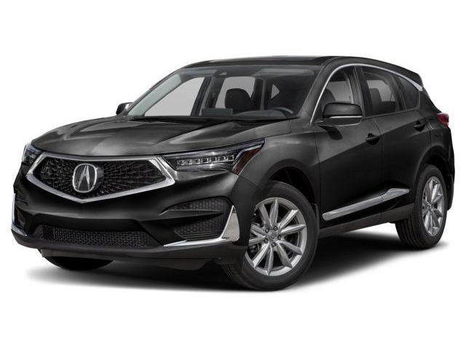
Used OEM ACURA Parts
Notes:
Acura is the American luxury vehicle marque of Japanese automaker Honda. The brand was launched in the United States and Canada on 27 March 1986, marketing luxury, performance, and high-performance vehicles. Acura holds the distinction of being the first American-Japanese automotive luxury brand. It is no coincidence that the Acura receives high ratings for safety on the highway. Not only will Acura get your family to their destination with comfort and speed, it will also offer peace of mind knowing that it has all the safety features that protects the riders if anything unexpected was to take place.

Slide 4
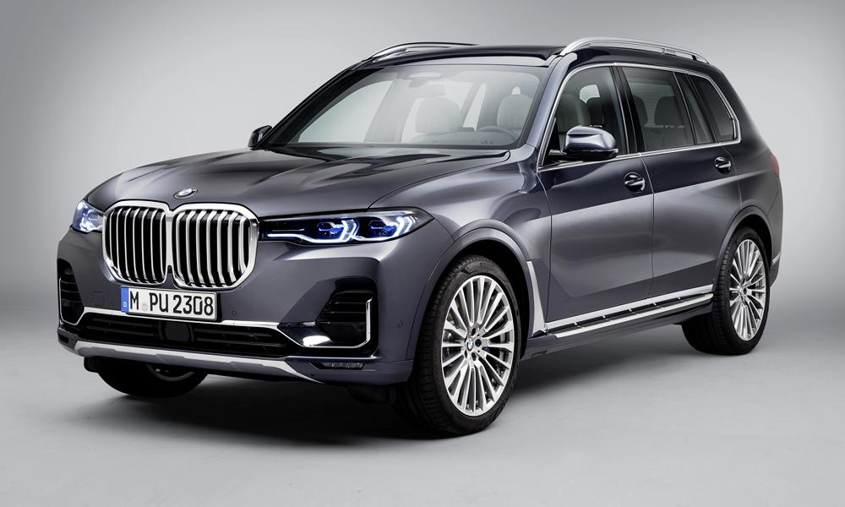
Used OEM BMW Parts
Notes:
BMW is a German multinational company which currently produces automobiles and motorcycles. The company was founded in 1916 and is headquartered in Munich, Bavaria. BMW produces motor vehicles in Germany, Brazil, China, India, South Africa, the United Kingdom, and the United States. In 2015, BMW was the world's twelfth largest producer of motor vehicles, with 2,279,503 vehicles produced. A small investment in the BMW auto parts today will save a substantial amount of money in the future and will ensure reliable transportation for years to come. The used BMW parts that are part of the regularly scheduled maintenance include spark plugs, fuel and air filters, radiator hoses as well as belts. Such parts are available for all the BMW models starting from 128i Parts to M6 parts to Z4 parts.

Slide 5
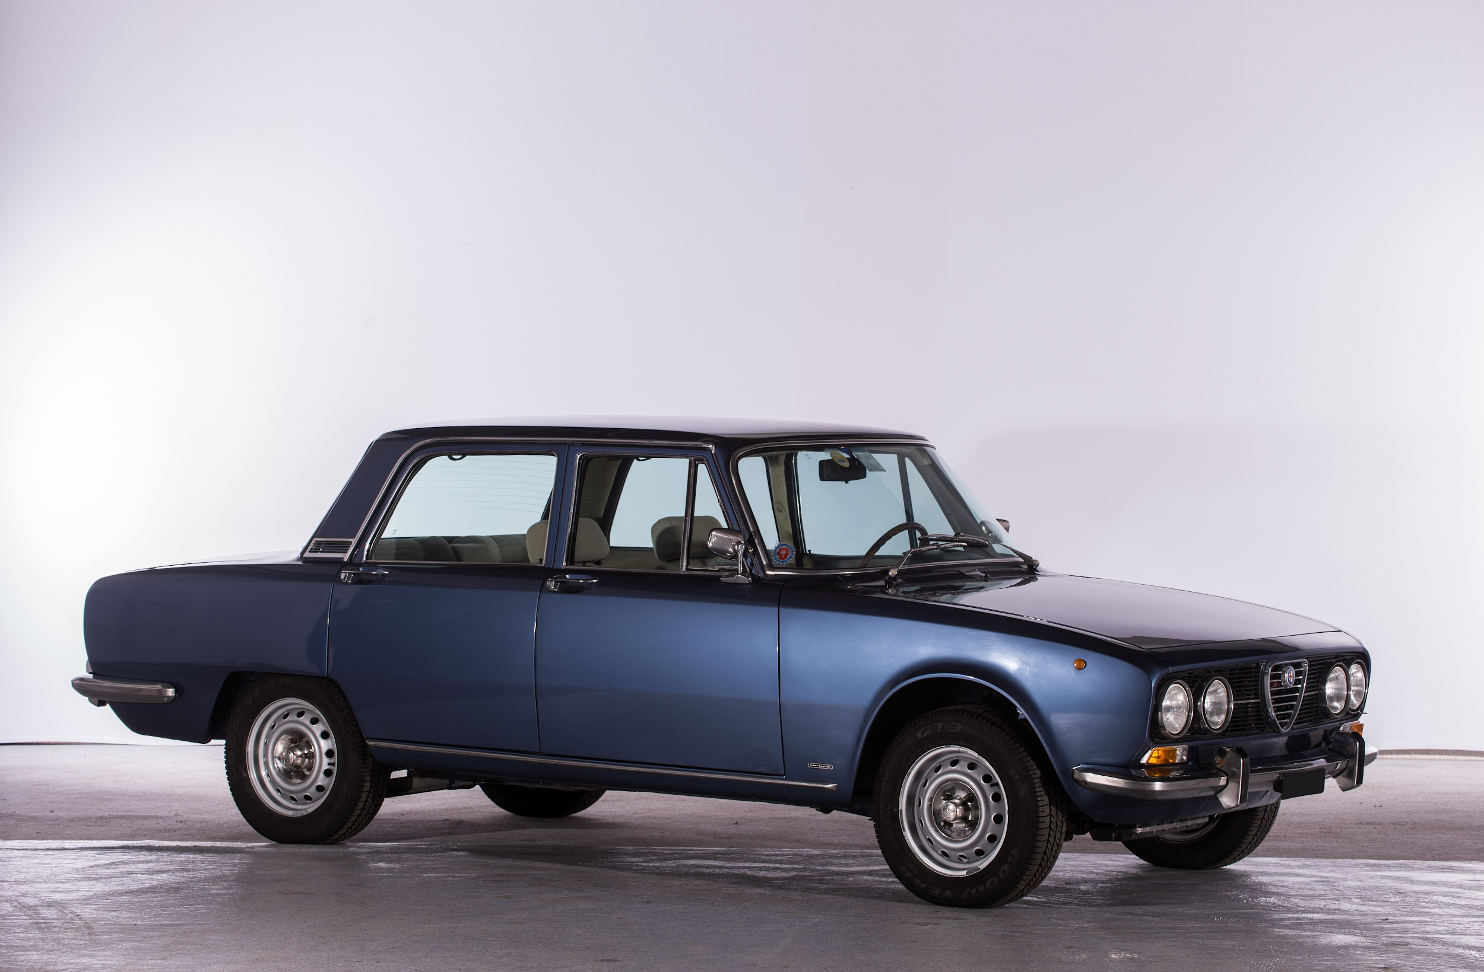
Used OEM ALFA-ROMEO Parts
Notes:
Alfa Romeo is an Italian luxury car manufacturer, founded by Frenchman Alexandre Darracq as A.L.F.A. The brand is known for sporty vehicles and has been involved in car racing since 1911. A new car production line was also launched which featured 24 HP and a car engine of 4.1 litres. The cars had a single shaft which helped the vehicle attain the maximum speed of about 62 mph. During the First World War, the company was purchased by Nicola Romeo. Alfa Romeo has competed successfully in Grand Prix motor racing, Formula One, sports car racing, touring car racing, and rallies.

Slide 6
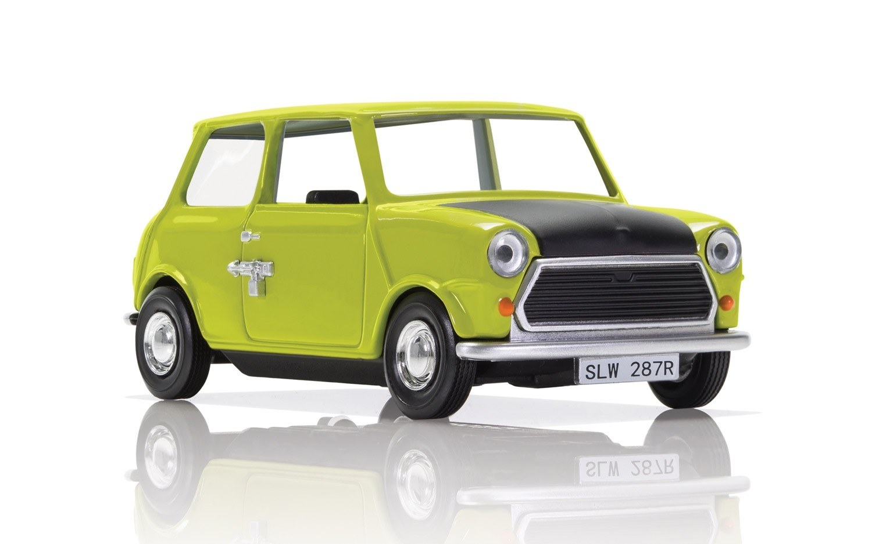
Used OEM BRITISH-LEYLAND Parts
Notes:
British Leyland was an automotive engineering and manufacturing conglomerate formed in the United Kingdom in 1968 as British Leyland Motor Corporation Ltd (BLMC), following the merger of Leyland Motors and British Motor Holdings. British Leyland had quite few merges with big car manufactures in England in different years. For example we can consider Austin and Jaguar. During the period of 1974 to 1979, the ruling government of England (Labour Government) at that period was having the major part of the shares and established a new company named “British Leyland Limited” and predominantly took of the control of the company. Buying the used auto parts will help you maintain your old vehicle. Repairing an old model will cost you less as compared to buying the new car. Replacing the old car parts with the auto parts will also increase the market value of your vehicle.

Slide 7
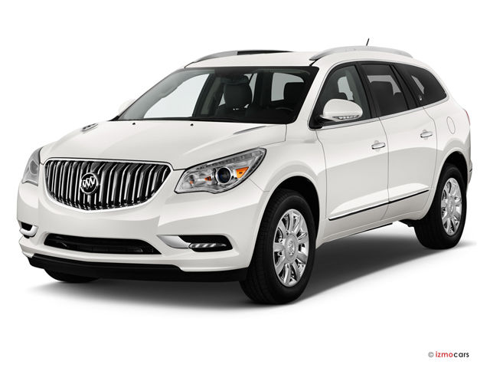
Used OEM BUICK Parts
Notes:
Buick is a division of the American automobile manufacturer General Motors (GM). It has the distinction of being among the first American marques of automobiles, and was the company that established General Motors in 1908. In 2015, Buick sold 1,231,941 vehicles, a record for the brand.[3] The main market is China, where 80% of Buick-branded automobiles are sold.[4] Buicks are also sold in the United States, Canada, Mexico and China. We offers a variety of quality salvage parts to you at discounted rates. You can buy the used auto parts and get them delivered to your house within a week. Also, keeping a record of your car including the car papers to identify the car make and model helps you get the right used car parts that are compatible with your vehicle.

Slide 8
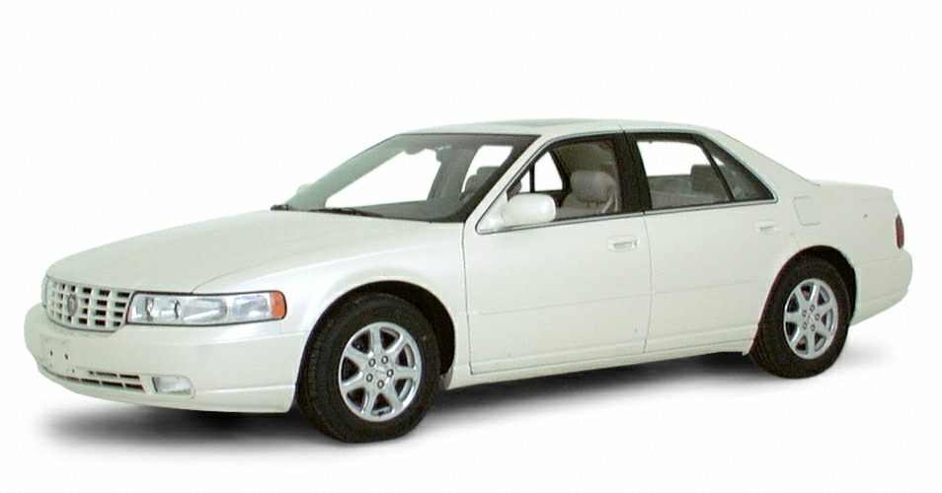
Used OEM CADILLAC Parts
Notes:
Cadillac is a division of the American automobile manufacturer General Motors (GM) that designs and builds luxury vehicles. Its major markets are the United States, Canada, and China. Cadillac vehicles are distributed in 34 additional markets worldwide. Cadillac automobiles are at the top of the luxury field within the United States.[2] In 2017, Cadillac's U.S. sales were 156,440 vehicles and its global sales were 356,467 vehicles. It is among the primogenital automobiles company in the world, and second in the USA only to the companion GM marque Buick. The firm was discovered in 1902 from the remnants of the Henry Ford Company. You can locate and buy used Cadillac parts from a number of sources like junkyards, salvage yards, auto parts sellers and online Cadillac parts sites. If you go for the salvage yards then you will be able to get the best price on the available auto parts, however, you will have to consider your judgment accountable for the quality of the OEM parts.

Slide 9
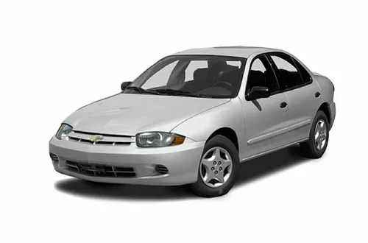
Used OEM CHEVY Parts
Notes:
Chevrolet is an American automobile division of the American manufacturer General Motors (GM). Louis Chevrolet and ousted General Motors founder William C. Durant started the company on November 3, 1911 as the Chevrolet Motor Car Company. Your Chevrolet vehicle represents a valuable investment and taking an active role in maintaining your cars will help you protect the investment. Proper maintenance of the vehicle by resorting to buy used Chevy parts will be the right way to go. We here can help you with anything to make sure you get the right used auto parts that are tested for quality and performance when rescued from salvage yards before they are even mentioned on our site for sale.

Slide 10
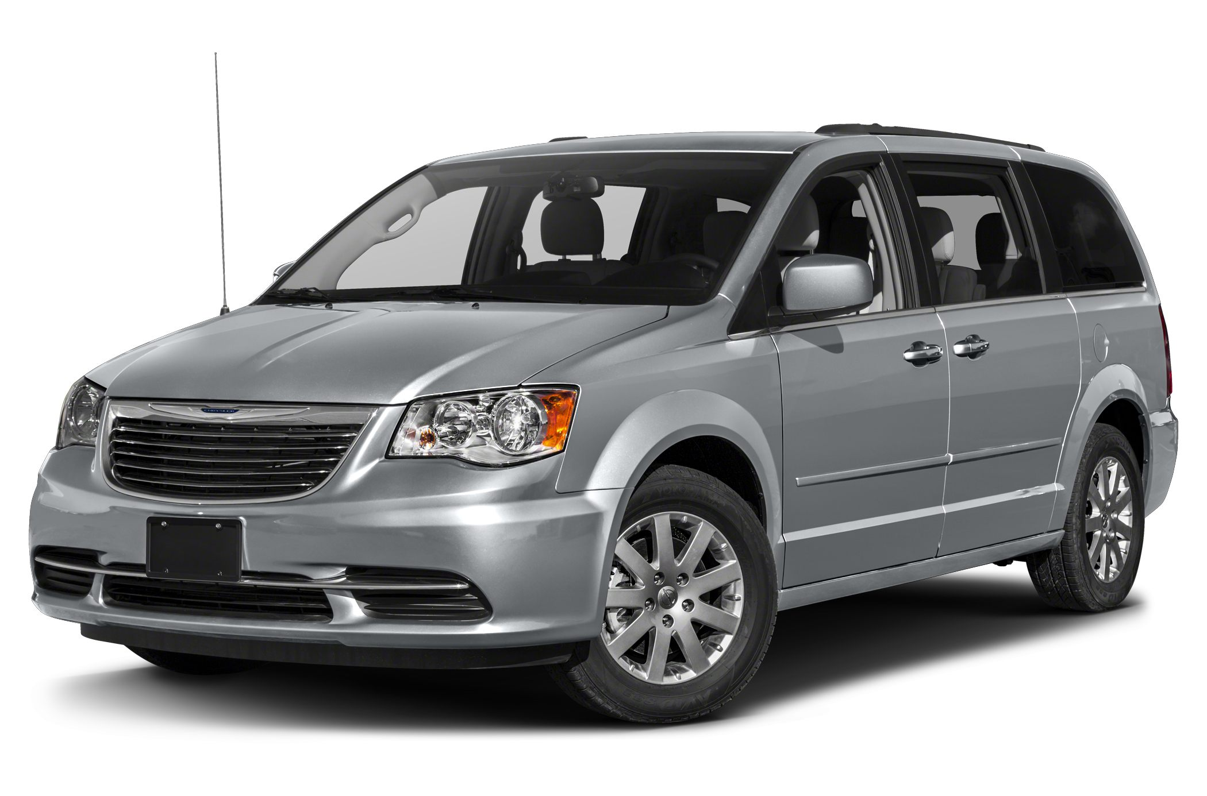
Used OEM CHRYSLER Parts
Notes:
Chrysler is one of the "Big Three" automobile manufacturers in the United States, headquartered in Auburn Hills, Michigan. Used Chrysler parts: Buy them to make all the difference in the performance of the vehicle.The point that all the cars and perfectly engineered machines must be maintained on a regular basis cannot be stressed enough. Your task for looking to buy used Chrysler parts does not have to be limited to the junkyards when you can get quality used car parts for the vehicle from the online Chrysler parts site for the most affordable price that also comes with quality and performance assurance. If we have look on the global sales of Chrysler then we might get to know that this company was in the 11th place in the list of World’s largest vetches manufacture which is ranked by the OICA in 2012. In the same year Chrysler has produced 2.37 million vehicles and it was the double figure of its production in 2010.

Slide 11
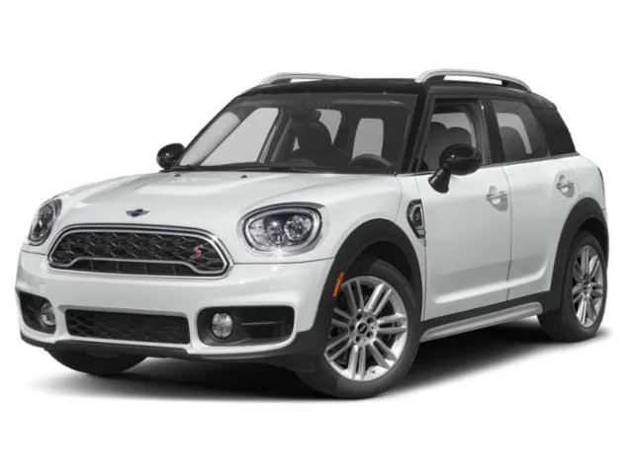
Used OEM COOPER Parts
Notes:
The Cooper Car Company is a car manufacturer founded in December 1947 by Charles Cooper and his son John Cooper. Together with John's boyhood friend, Eric Brandon, they began by building racing cars in Charles's small garage in Surbiton, Surrey, England, in 1946. The Mini Cooper was also awarded the title of the second most influential car in the 20th century. The car has also been marketed under the names of Austin and Morris. In 1994, after the BMW bought the Rover Group, the production of the car was still continued using the same name. If you go for used parts from us, you get the additional benefits such as warranty and easy returns. The OEM parts come with a warranty which ensures you that the 3 other makes parts online you purchase are free from defects and can be easily returned if you are not satisfied with the quality.

Slide 12
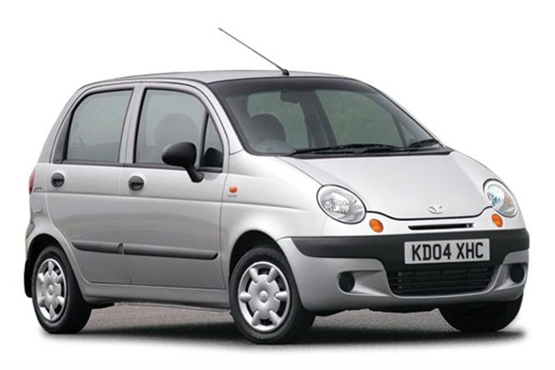
Used OEM DAEWOO Parts
Notes:
Daewoo Motors was a South Korean automotive company established in 1983, part of the Daewoo Group.
The company was first established as National Motor in 1937 in Bupyeong-gu, Incheon, Japanese Korea. The name was changed to Saenara Motor in November 1962. Saenara was assembling and selling the Datsun Bluebird PL310.[1] The first automobile company in Korea, Saenara was equipped with modern assembly facilities, and was established after the Automobile Industry Promotion Policy was announced by the South Korean government in 1962.[2] Saenara Motor was then bought by Shinjin Industrial in 1965, which changed its name to Shinjin Motors after establishing collaborations with Toyota.

Slide 13
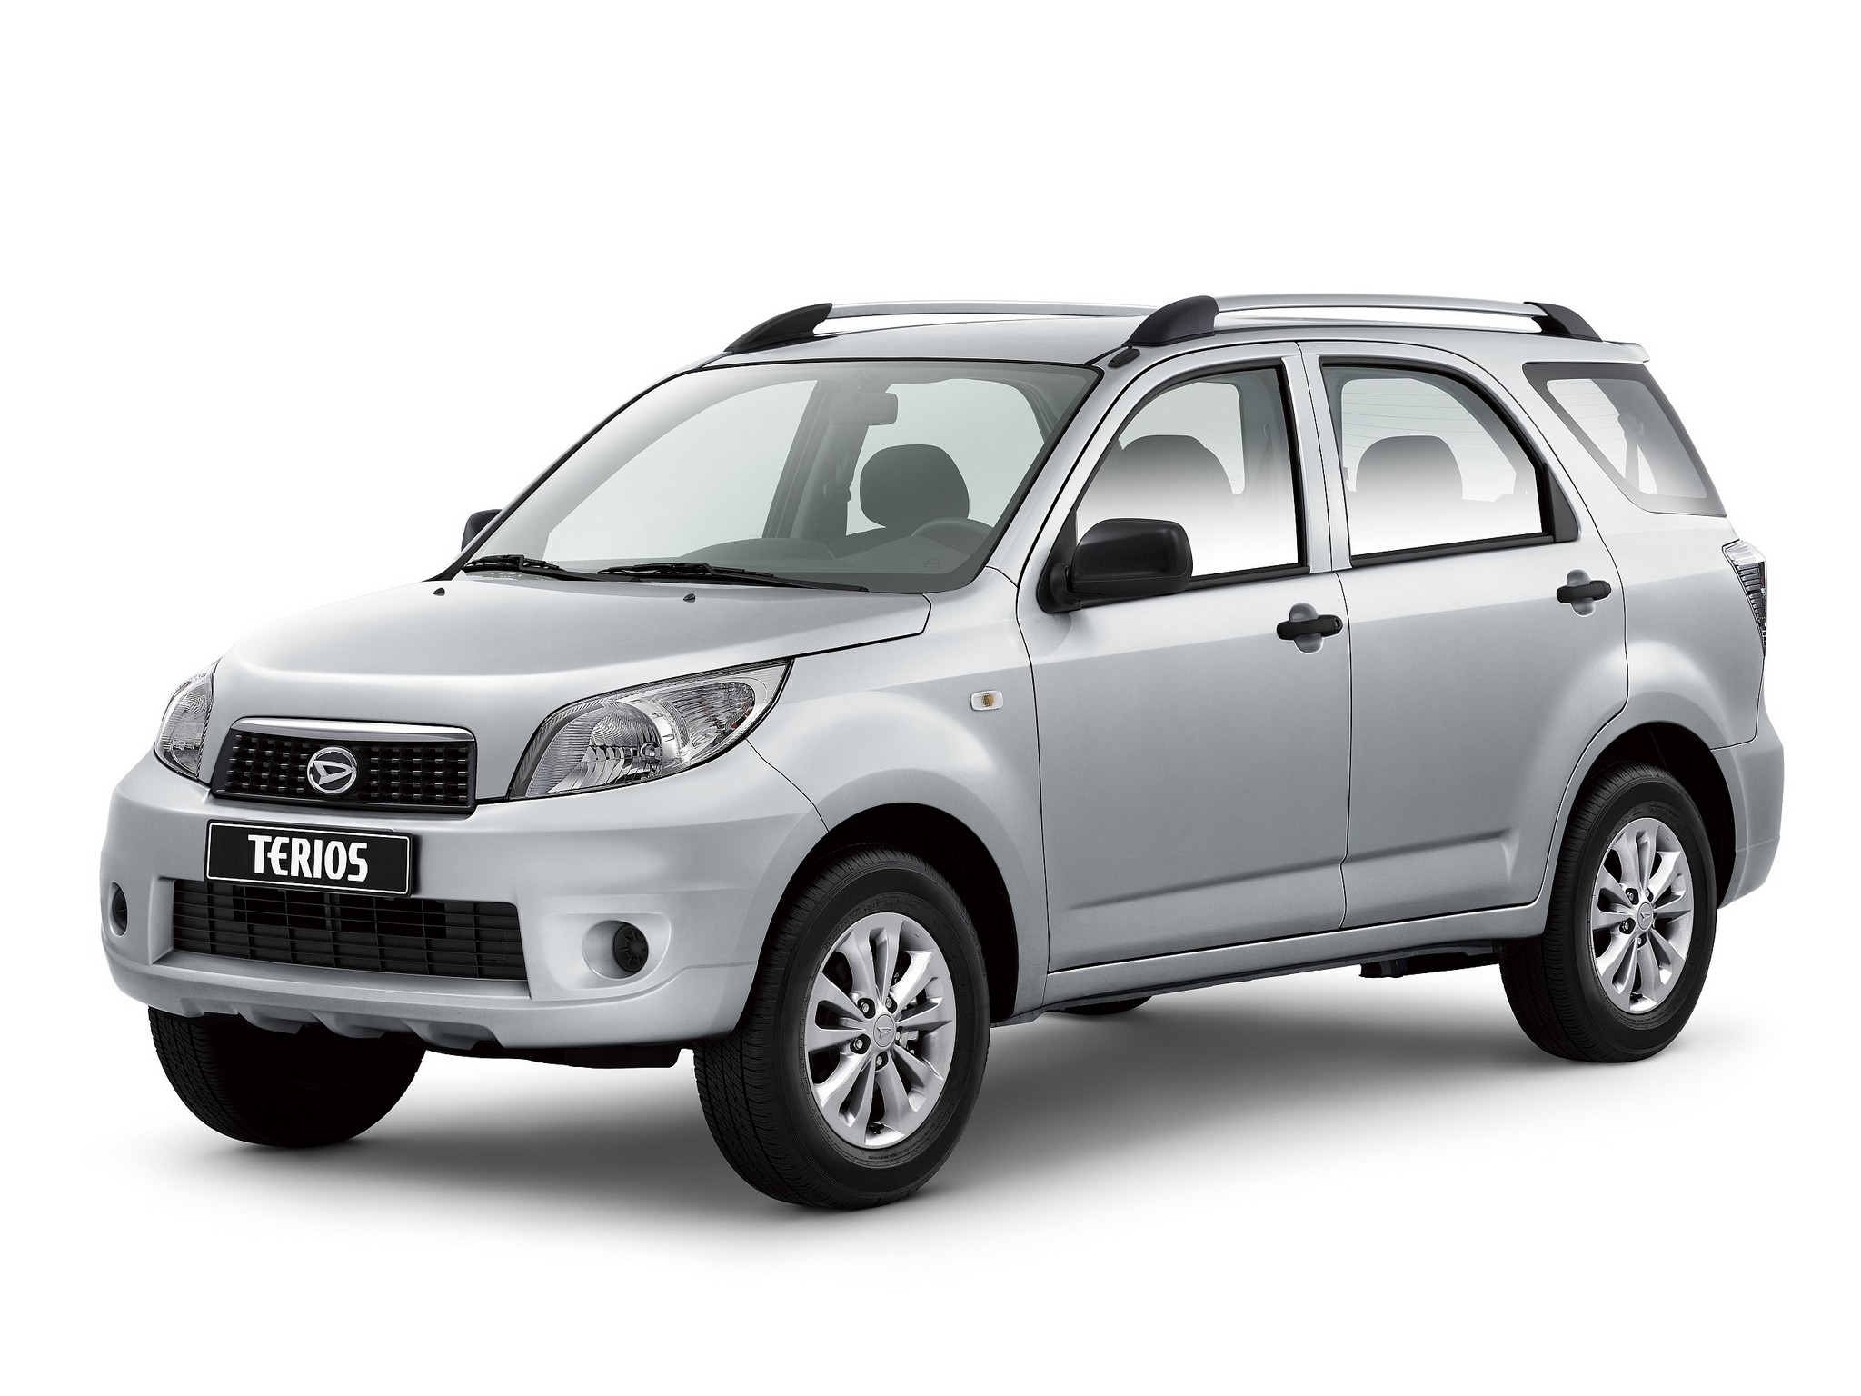
Used OEM DAIHATSU Parts
Notes:
Daihatsu Motor Co Ltd. trading as Daihatsu, is one of the oldest surviving Japanese internal combustion engine manufacturers, later known for its range of smaller kei models and off-road vehicles. The headquarters are located in Ikeda, Osaka Prefecture. The company is a wholly owned subsidiary of the Toyota Motor Corporation since August 2016.
Daihatsu was formed in 1951 as a successor to Hatsudoki Seizo Co. Ltd, founded in 1907, as part of Hatsudoki's major restructure. Hatsudoki's formation was largely influenced by the Engineering Department's faculty of Osaka University, to develop a gasoline-powered engine for small, stationary power plants.

Slide 14
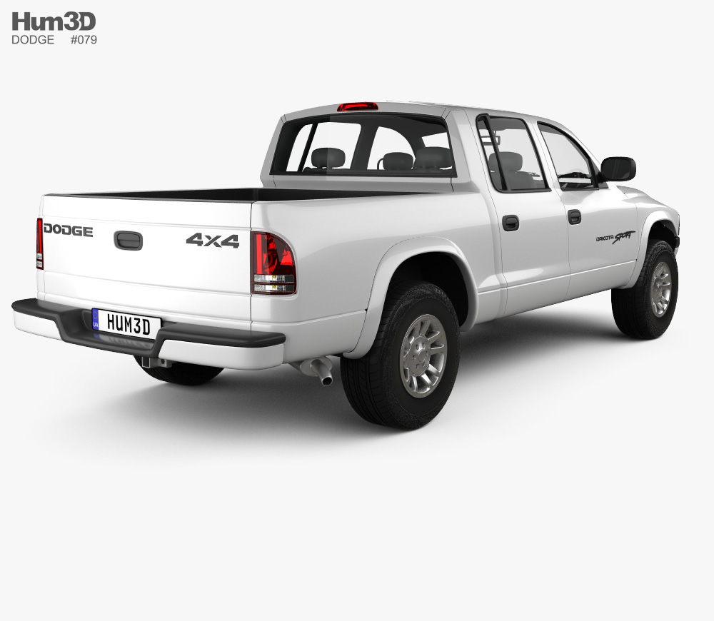
Used OEM DODGE Parts
Notes:
Dodge is an American brand of automobile manufactured by FCA US LLC (formerly known as Chrysler Group LLC), based in Auburn Hills, Michigan. Dodge vehicles currently include performance cars, though for much of its existence Dodge was Chrysler's mid-priced brand above Plymouth. In the past few years, Dodge has come to be known famously for its truck models as for its prodigious passenger car output. The Dodge caravan is famous for its innovation and depending on that feature; your problematic situation can be intensified if you want to buy used Dodge parts from outside for replacement purposes. The best thing about Used Parts is that we do not discard the products or parts rather we save the valuable ones from the junkyards. Our aim here is to use the auto parts till the time they can be of value for the smooth running and long lasting performance of the vehicle.

Slide 15
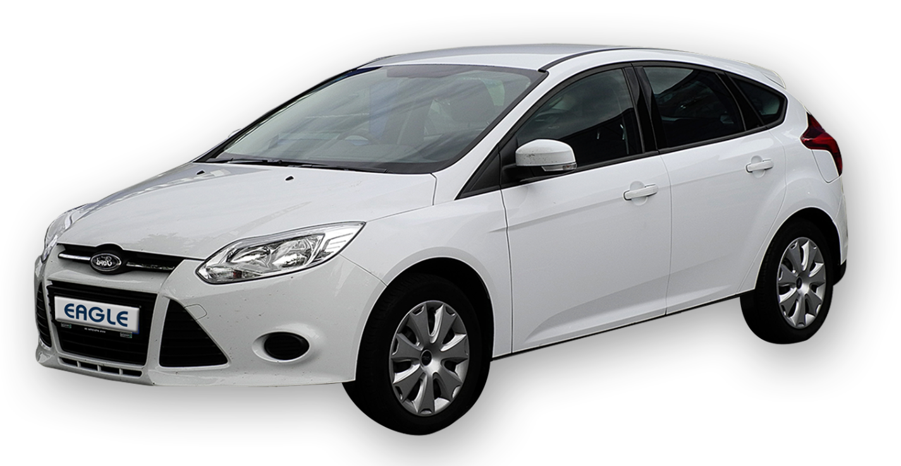
Used OEM EAGLE Parts
Notes:
Eagle was a marque of the Chrysler Corporation following the purchase of American Motors Corporation (AMC) in 1987 and marketed through the end of the 1998 model year. It was aimed at the enthusiast driver and promoted as more "European" than the automaker's similar models.The "Eagle" name was taken by Chrysler from the four-wheel drive AMC Eagle models that were introduced for the 1980 model year.[2] This was the last of American Motors' wholly U.S.-designed vehicles and arguably the first modern mass-production crossover automobile. The Eagle name also appeared on a number of Jeep trim packages and special models that included the J-10 pickup trucks, the wide-track Cherokee SJ, as well as the CJ-5 and CJ-7 models starting in 1976.You can also choose the junk yards and salvage yards to buy the car parts that are not available online. You can also test the used car parts to ensure that they work properly.

Slide 16
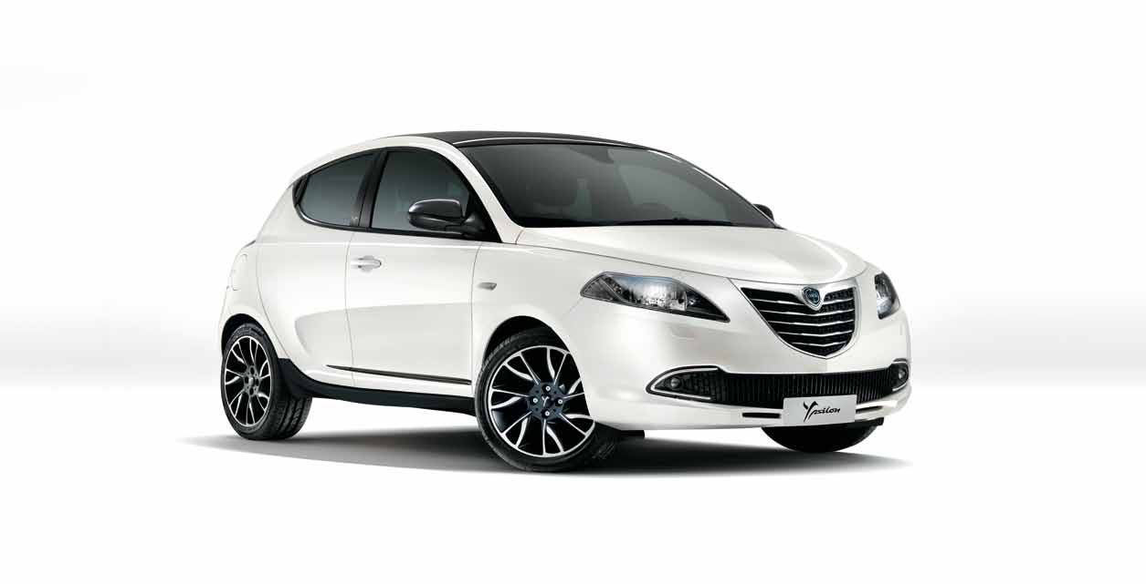
Used OEM FIAT-LANCIA Parts
Notes:
Fiat is an Italian automobile manufacturer, a subsidiary of FCA Italy S.p.A., which is part of Fiat Chrysler Automobiles (previously Fiat S.p.A.). Fiat Automobiles was formed in January 2007 when Fiat reorganized its automobile business,[2] and traces its history back to 1899 when the first Fiat automobile, the Fiat 4 HP, was produced.Fiat Automobiles is the largest automobile manufacturer in Italy. During its more than century-long history, it remained the largest automobile manufacturer in Europe and the third in the world after General Motors and Ford for over twenty years, until the car industry crisis in the late 1980s. You can be confident in your decision while purchasing the salvage parts from QAP as you get the warranty and the option of easy returns and exchange. This way you can return the used car parts if you are not satisfied with its quality.

Slide 17
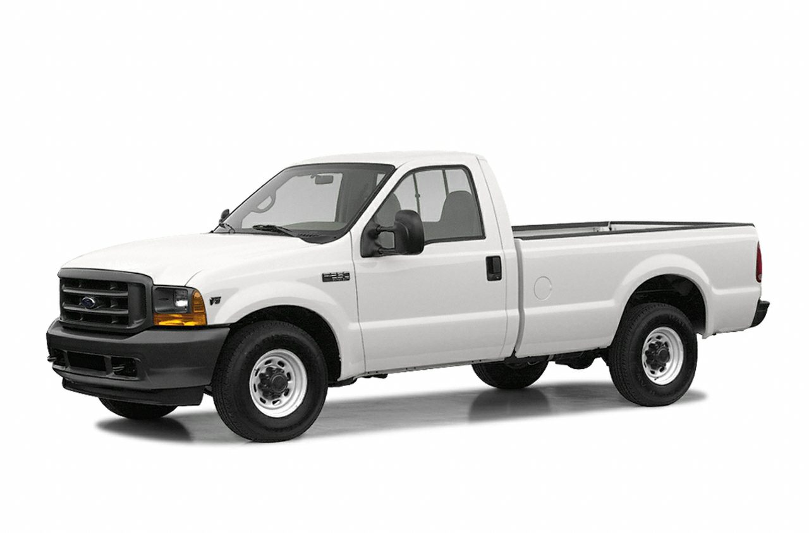
Used OEM FORD Parts
Notes:
Ford Motor Company is a multinational automaker that has its main headquarter in Dearborn, Michigan, a suburb of Detroit. It was founded by Henry Ford and incorporated on June 16, 1903. The company sells automobiles and commercial vehicles under the Ford brand and most luxury cars under the Lincoln brand. Ford also owns Brazilian SUV manufacturer Troller, an 8% stake in Aston Martin of the United Kingdom and a 32% stake in Jiangling Motors.Apart from its domestic operations, the company also operates in the markets of Europe, South America, Africa, Asia Pacific and the Middle East. Ford is staying in the fourth place in largest automobile manufacture groups in the world and the place was based in their overall sales in worldwide. Before 2007 Ford was in the second place based on their sales in United States, the thing is they were keeping that position as a constant for more than half century but unfortunately they have been pushed back to the third place in 2007. More than 6.5 million carriages has been produced by Ford and Ford has more than 245000 employees in all of their branches worldwide.

Slide 18
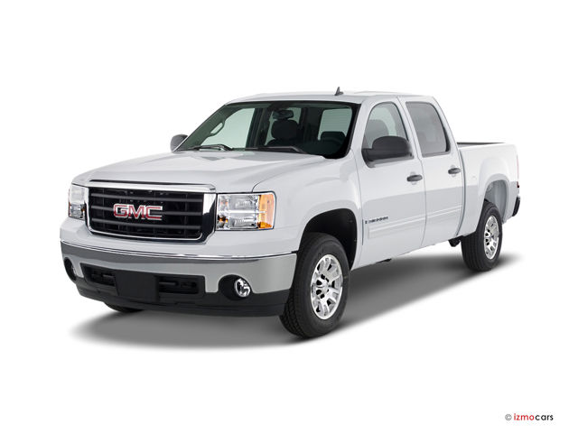
Used OEM GMC Parts
Notes:
General Motors Company (GMC), formally the GMC Division of General Motors LLC, is a division of the American automobile manufacturer General Motors (GM) that primarily focuses on trucks and utility vehicles. GMC sells pickup and commercial trucks, buses, vans, military vehicles, and sport utility vehicles marketed worldwide by General Motors. In North America, GMC dealerships are almost always also Buick dealerships, allowing the same dealer to market both upmarket cars and upmarket trucks. The GMC truck has able to reach New York City from Seattle within thirty days in 1916 and around in 1926 A2 truck has took around five days to travel between New York and San Francisco. In the meantime which was in the mid of 1925 GM had a another purchase of Yellow Coaches that was a bus manufacturing company based in Chicago, after this purchase GM has changed the name of their truck and coach providing division and they export the buses to Canada and to the other states in United States. At the current GMC is manufacturing load trucks, vans and other different truck based carriages.

Slide 19
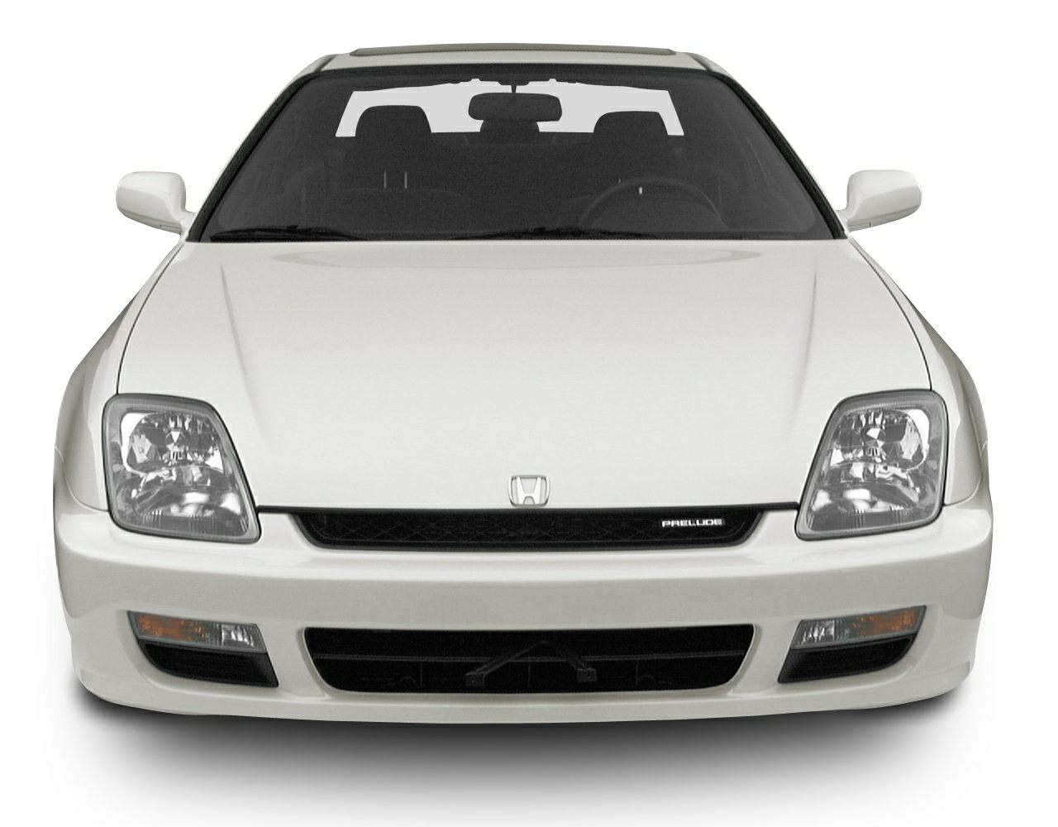
Used OEM HONDA Parts
Notes:
Honda Motor Company, Ltd.is a Japanese public multinational conglomerate corporation primarily known as a manufacturer of automobiles, aircraft, motorcycles, and power equipment.Honda has been the world's largest motorcycle manufacturer since 1959.Honda was the first Japanese automobile manufacturer to release a dedicated luxury brand, Acura, in 1986. In the world Honda is grabbing the sixth place of largest automobile manufactures list. Not only this Honda brand is the largest engine manufacturer worldwide as it produces more than 14 million engines per each year. For creating various types of advertisement Honda gives more importance to it and following different styles than the other manufactures in the field. For example we can take the advertisement that had launched in United Kingdom called Cog advertisement in 2003. In the following years the dream advertisements had issued and in 2007 Honda had introduced the animations in their advertisements which were initially launched in the United States.

Slide 20
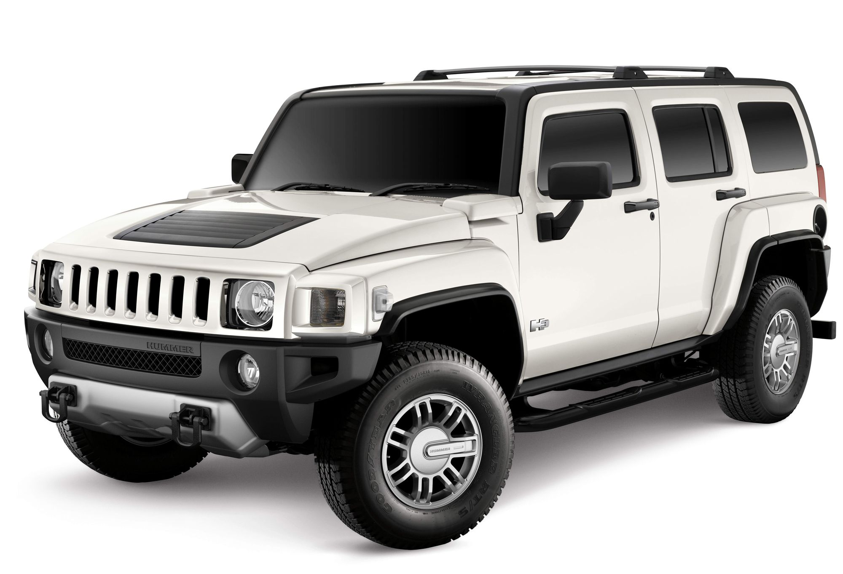
Used OEM HUMMER Parts
Notes:
Hummer was a brand of trucks and SUVs, first marketed in 1992 when AM General began selling a civilian version of the M998 Humvee.[1] In 1998, General Motors (GM) purchased the brand name from AM General and marketed three vehicles: the original Hummer H1, based on the military Humvee, as well as the new H2 and H3 models that were based on smaller, civilian-market GM platforms. Not only for the vehicles to armed forces but also AM general has decided to launch and market a civilian version of Humvee in 1980 which was the Hummer product to the United States Army, this version had the same structure as an Army vehicle but they have changed the interior based technologies actually added some like air condition system, sound system and so on whichever relates to normal people. In 1992 AM General has begun the sales f this civilian version named “Hummer”. Raving based vehicles also been created by this brand, in 1993. Hummer race team has designed the new racing vehicle with safety systems, absorbers and big tires. In the following years in Dakar rally races this vehicle has placed the positions including 10 and the two wheel race vehicle designed by the same team won the Baja 1000 race as well.

Slide 21
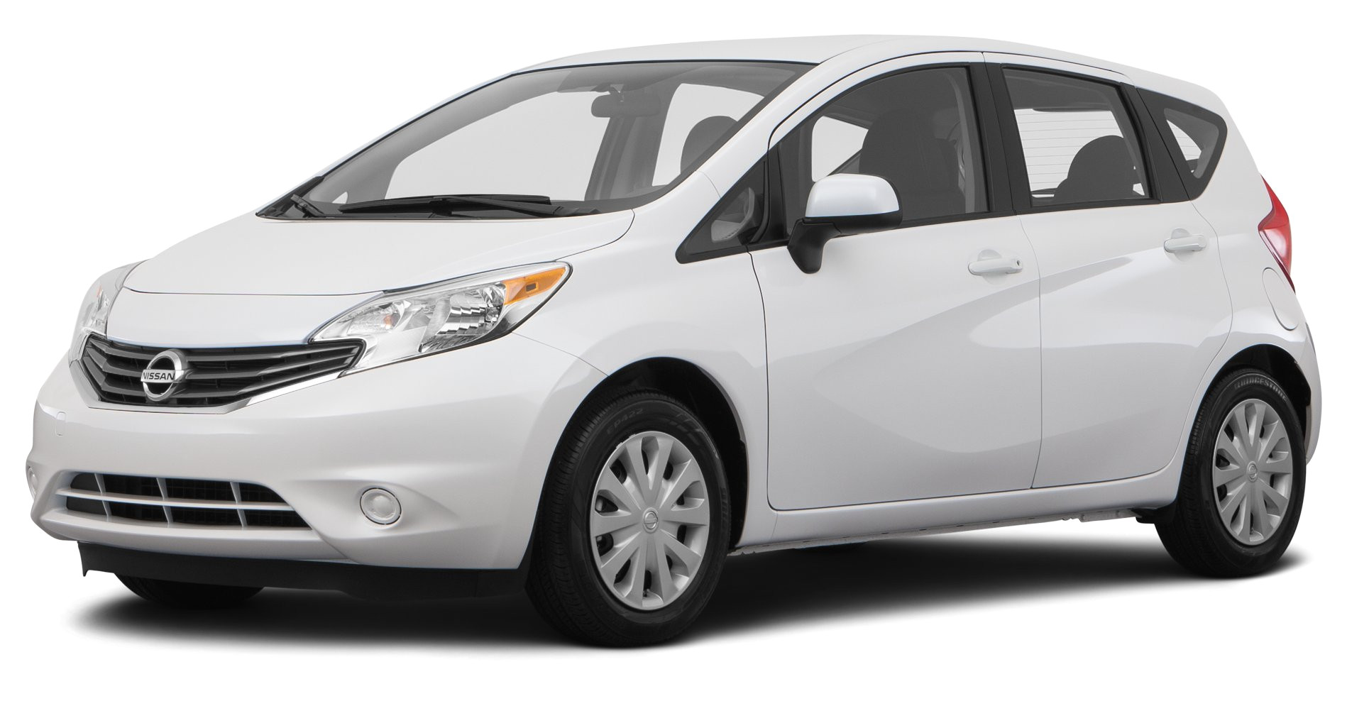
Used OEM HYUNDAI Parts
Notes:
The Hyundai Motor Company, commonly known as Hyundai Motors is a South Korean multinational automotive manufacturer headquartered in Seoul. The company was founded in 1967 and, along with its 32.8% owned subsidiary, Kia Motors, and its 100% owned luxury subsidiary Genesis Motor, altogether comprise the Hyundai Motor Group. It is the third largest vehicle manufacturer in the world. Hyundai operates the world's largest integrated automobile manufacturing facility[6] in Ulsan, South Korea which has an annual production capacity of 1.6 million units. The company employs about 75,000 people worldwide. Hyundai vehicles are sold in 193 countries through some 5,000 dealerships and showrooms. Meanwhile the founder of the company, Chung also died in 2001, after these two incidents happened; Hyundai group had reorganization and went through some struggles as well. Also Hyundai group was broke down and after 2001 they conduct only elevator manufacturing, shipping services and tourism. Number of few companies has “Hyundai” in their names at the current are not legally affiliated to the original Hyundai group, however some of the Chung’s relations are keep running some of the subsidiaries of Hyundai group still now.

Slide 22
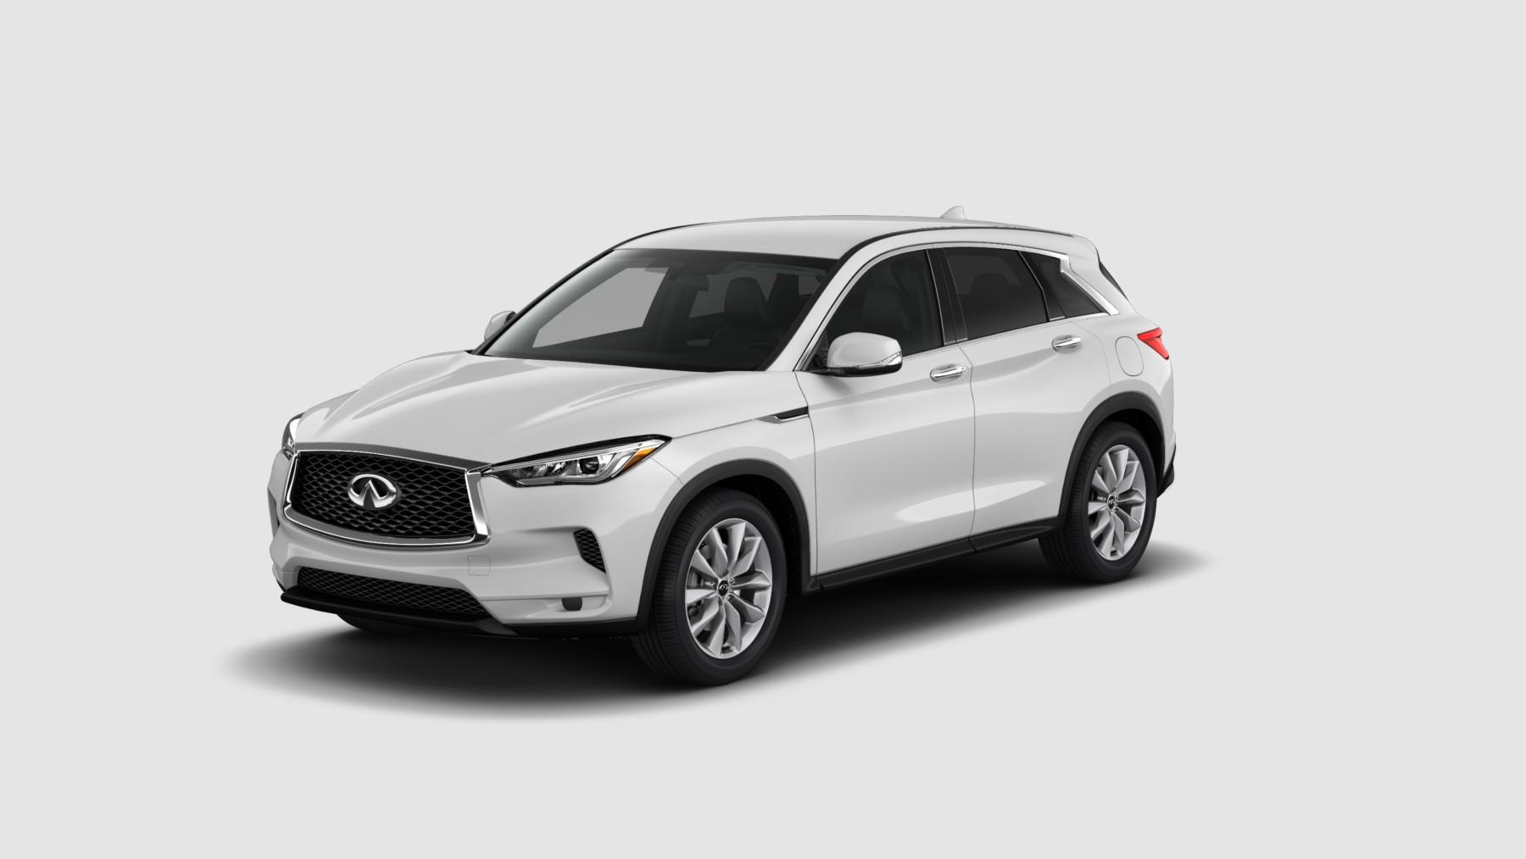
Used OEM INFINITI Parts
Notes:
INFINITI is the luxury vehicle division of Japanese automaker Nissan. Infiniti officially started selling vehicles on November 8, 1989, in North America. The marketing network for Infiniti-branded vehicles includes dealers in over 50 countries. In 2012, Infiniti moved its global headquarters from the Nissan corporate building in Yokohama and incorporated in Hong Kong as Infiniti Global Limited, with Carlos Ghosn intending for Infiniti to have a greater focus on the burgeoning luxury market in mainland China as it forecast the country to become the largest luxury car market. In 2013, Infiniti has showcased their new model car called “Q30” in Frankfurt Motor Show and after that Infiniti has made a expressive impact and had a good start in their sales. After producing the Q60 crossover known as JX35, Infiniti has started to launch their products outside Japan officially. At the present Infiniti is on producing television series too such as “Where are we going dad” which was a Chinese television series, along with their automobile manufacturing.

Slide 23
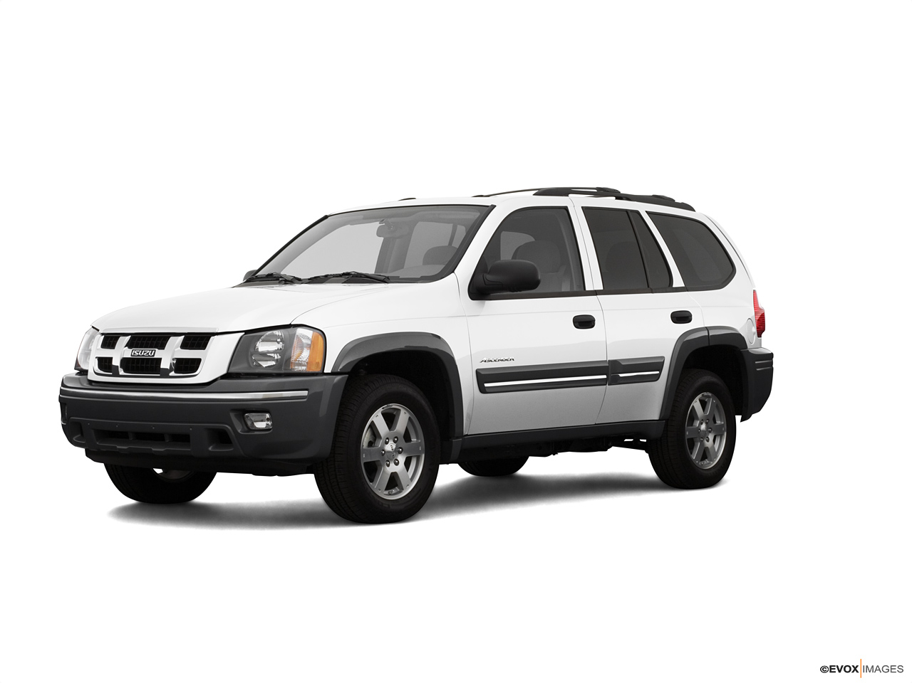
Used OEM ISUZU Parts
Notes:
Isuzu Motors Ltd is a Japanese commercial vehicle and diesel engine manufacturing company headquartered in Tokyo. Its principal activity is the production, marketing and sale of Isuzu commercial vehicles and diesel engines. Isuzu's primary market focus is on commercial diesel-powered truck, buses and construction, while their Japanese competitor Yanmar focuses on commercial-level powerplants and generators. Isuzu is well known for their truck based vehicles and their more popular in Asian and African continents too. But in the 1990s Isuzu has collapsed on the sales of their small level sedans and cars. However Isuzu managed to do lack of sales in United States and get abandoned the sales. 7th of November 2007, Toyota has obtained the 5.9% and after that Isuzu became the third largest shareholder of Toyota.

Slide 24
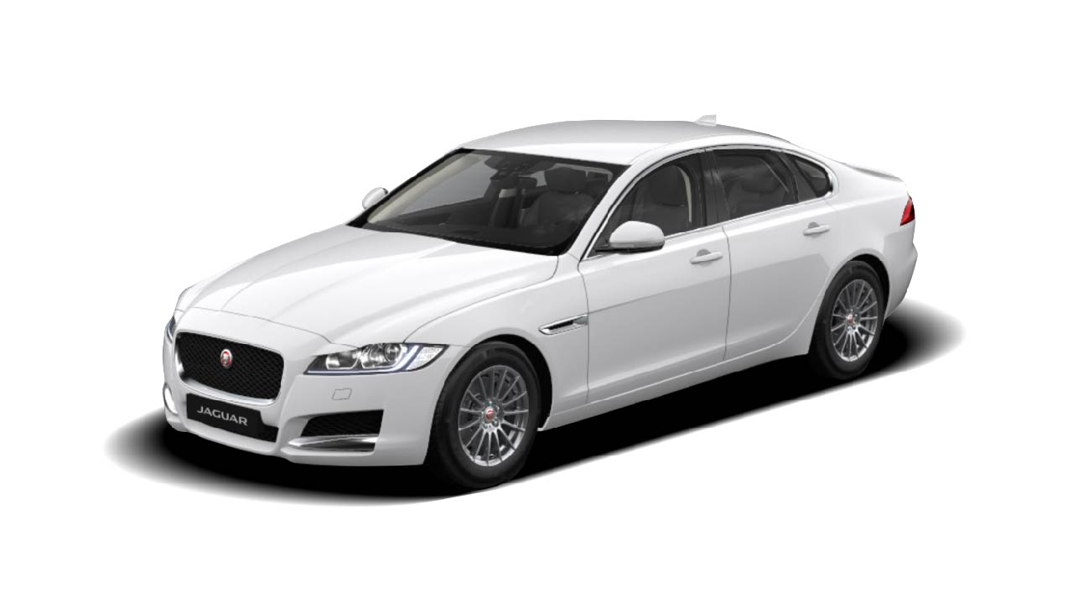
Used OEM JAGUAR Parts
Notes:
JAGUAR is the luxury vehicle brand of Jaguar Land Rover,[2][1] a British multinational car manufacturer with its headquarters in Whitley, Coventry, England. Jaguar Cars was the company that was responsible for the production of Jaguar cars until its operations were fully merged with those of Land Rover to form Jaguar Land Rover on 1 January 2013. The Jaguar brand was getting popular after they manufactured and marketed the sports car models like Jaguar XK120, Jaguar XK 140 and other few in the periods of 1950s. for such long years Jaguar was suing the slogan called “Grace, Space, Pace” and they have achieved records in their sales during they were using this slogan. In 1951 and in 1953, these were the years the Jaguar model sports cars were won the championship of the Le Mans 24 Hour Race and those were real delightful moments in their long history. We can say the X models and the R models are the stylish products of Jaguar till now. Under the product of luxury Jaguar has released their Jaguar KX in 2006 and its structure has made by aluminium and it was a two door vehicle with fixed roof. In 1990 Ford acquired Jaguar Cars and it remained in their ownership, joined in 2000 by Land Rover, till 2008. Ford then sold both Jaguar and Land Rover to Tata Motors. Tata created Jaguar Land Rover as a subsidiary holding company. At operating company level, in 2013 Jaguar Cars was merged with Land Rover to form Jaguar Land Rover Limited as the single design, manufacture, sales company and brand owner for both Jaguar and Land Rover vehicles.

Slide 25
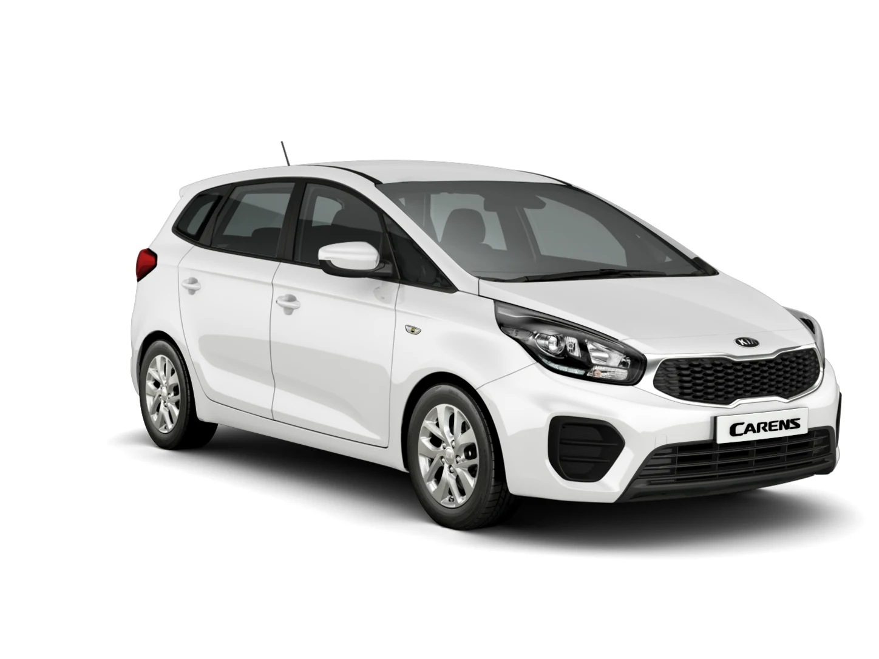
Used OEM KIA Parts
Notes:
Kia Motors Corporation, commonly known as Kia Motors is South Korea's second-largest automobile manufacturer, following the Hyundai Motor Company, with sales of over 3.3 million vehicles in 2015. As of December 2015, the Kia Motor Corporation is minority owned by Hyundai, which owns a 33.88% stake valued at just over US$6 billion. Kia in turn is a minority owner of more than twenty Hyundai subsidiaries ranging from 4.9% up to 45.37%, totaling more than US$8.3 billion. As a proud moment of Kia Motors America, they have sponsored the event of first United States Assemble plant in West point in Georgia in the huge cost of one billion dollars in October 2006. At the present Kia has become the fastest growing automobile manufacturer purposely for their car models in United Kingdom, this growth has happened after Kia has focused on their sales and operations In European continents from 2005.

Slide 26
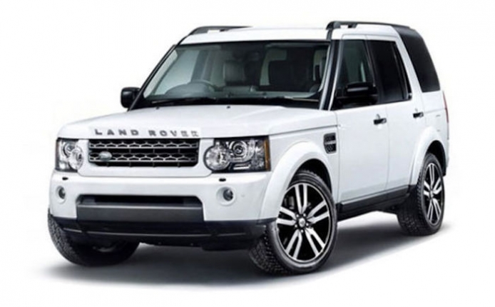
Used OEM LAND-ROVER Parts
Notes:
Land Rover is a luxury car brand that specialises in four-wheel-drivevehicles, owned by British multinational car manufacturer Jaguar Land Rover, which has been owned by India's Tata Motors since 2008.[4] The Land Rover is regarded as a British icon, and was granted a Royal Warrant by King George VI in 1951. The Land Rover name was originally used by the Rover Company for the Land Rover Series, launched in 1948. It developed into a brand encompassing a range of four-wheel-drive models, including the Defender, Discovery, Freelander, Range Rover, Range Rover Sport, and Range Rover Evoque. Land Rovers are currently assembled in England, India, China, and other markets.The design for the original vehicle was started in 1947 by Maurice Wilks. It was simply called Land Rover (the terms "Series" and "Defender" are retroactive and only introduced in the 1990s). Wilks, chief designer at the Rover Company, on his farm in Newborough, Anglesey, When the launch of this brand happened, Land Rover was not an independent company; it was a marque of Rover’s group, after several years Land Rover became independent. At that time Land Rover was producing variety of four wheels carriages under the control of British Leyland, BMW and other few.

Slide 27
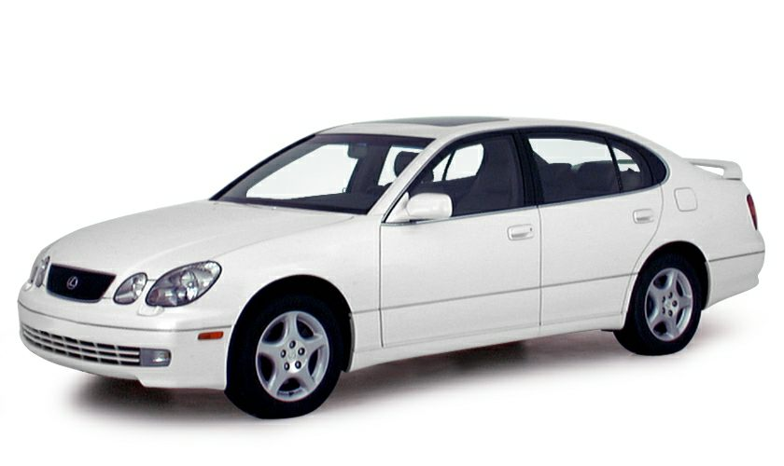
Used OEM LEXUS Parts
Notes:
Lexus is the luxury vehicle division of the Japanese automaker Toyota. The Lexus brand is marketed in more than 70 countries and territories worldwide and has become Japan's largest-selling make of premium cars. It has ranked among the 10 largest Japanese global brands in market value. Lexus is headquartered in Nagoya, Japan. Operational centers are located in Brussels, Belgium and the U.S. in Plano, Texas. Lexus originated from a corporate project to develop a new premium sedan, code-named F1, which began in 1983 and culminated in the launch of the Lexus LS in 1989. Subsequently, the division added sedan, coupé, convertible and SUV models. Lexus did not exist as a brand in its home market until 2005, and all vehicles marketed internationally as Lexus from 1989 to 2005 were released in Japan under the Toyota marque and an equivalent model name. In 2005, a hybrid version of the RX crossover debuted and additional hybrid models later joined the division's lineup. Lexus launched its own F marque performance division in 2007 with the debut of the IS F sport sedan, followed by the LFAsupercar in 2009.

Slide 28
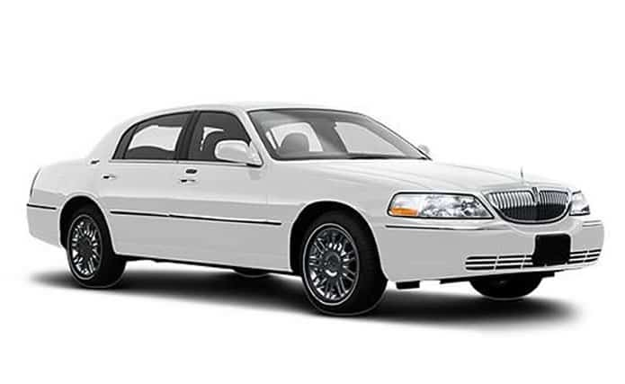
Used OEM LINCOLN Parts
Notes:
Lincoln, formally the Lincoln Motor Company, is a luxury vehicle brand of the American manufacturer Ford Motor Company. Marketed among the top luxury brands in the United States, Lincoln has competed closely against Cadillac for nearly its entire existence. Lincoln has the distinction of establishing the personal luxury car segment, with the entry of the Lincoln Continental into mass production in 1940.
Lincoln Motor Company was founded in 1917 by Henry M. Leland, naming it after Abraham Lincoln; in 1922, Lincoln was acquired by Ford.[5] Following World War II, Ford formed the Lincoln-Mercury Division, pairing Lincoln with its mid-range Mercury brand through 2010. In 2012, Ford rebranded the Lincoln division under its original name, Lincoln Motor Company.
Lincoln remains the sole luxury nameplate of Ford Motor Company. The current product range of Lincoln consists of sedans, crossovers, and SUVs. Outside of retail markets, Lincoln has produced vehicles for limousine and livery use throughout its entire existence, with several examples used as official state limousines for Presidents of the United States.

Slide 29
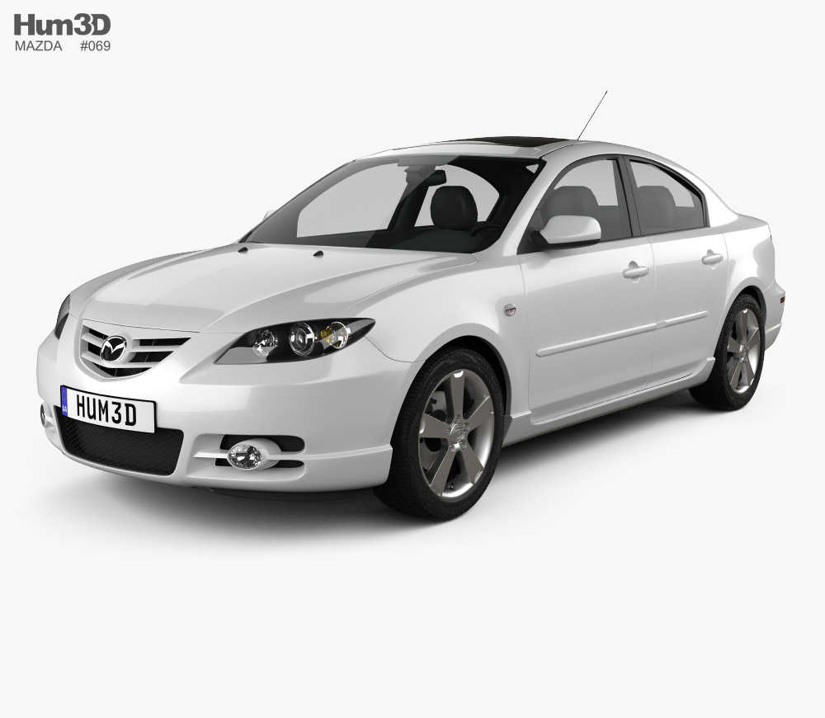
Used OEM MAZDA Parts
Notes:
Mazda Motor Corporation commonly referred to as simply Mazda, is a Japanesemultinational automaker based in Fuchū, Aki District, Hiroshima Prefecture, Japan. In 2015, Mazda produced 1.5 million vehicles for global sales, the majority of which (nearly 1 million) were produced in the company's Japanese plants, with the remainder coming from a variety of other plants worldwide.[4] In 2015, Mazda was the fifteenth biggest automaker by production worldwide. In 2007 Mazda has delivered more than 1.3 million carriages for the worldwide sales, in these products, Mazda has manufactured nearly one million vehicles from their Japanese factory particularly. Mazda has reached the fifteenth place in the World biggest automobile production companies list in 2011. Mazda was having many badges in different periods, for example during the period of 1934 and 1936 Mazda had badge which concludes only the word “Mazda” in stylish format. After wards they keep changing their logo and finally from 1997 to present they are having a stylish logo with a winged “M”.

Slide 30
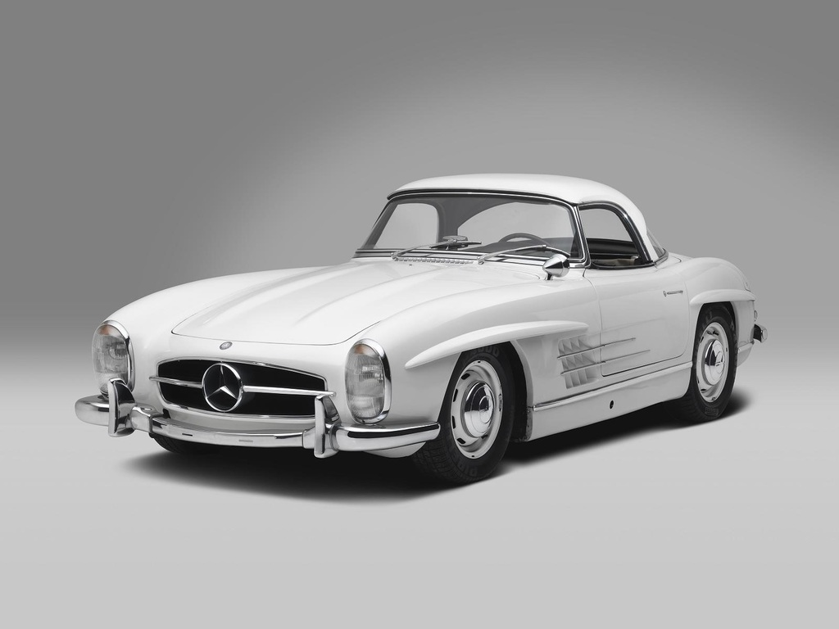
Used OEM MERCEDES-BENZ Parts
Notes:
MERCEDES-BENZ is a German global automobile marque and a division of Daimler AG. The brand is known for luxury vehicles, buses, coaches, and trucks. The headquarters is in Stuttgart, Baden-Württemberg. The name first appeared in 1926 under Daimler-Benz. In 2018, Mercedes-Benz was the biggest selling premium vehicle brand in the world, having sold 2.31 million passenger cars. In 2005 Mercedes brand had some struggle periods and they were dropped down in the market. However in 2007 they have managed to reached the formal place and reputation, for example they have come to fifth pace from 25th place in the automobile industry and got more and more achievement awards for their products. Among the awards, the “Platinum Plant Quality Award2 is the important in grabbed by Mercedes for its plant in Sindelfingen located in Germany. In 9151 Mercedes has created the most innovative part which was called “Safety cage” or “Safety cell”: this creation was become the most popular and most wanted thing based on secureness in the automobile industry. Anti-lock brakes, Traction control and other few discoveries were took Mercedes to the top in the European market.

Slide 31
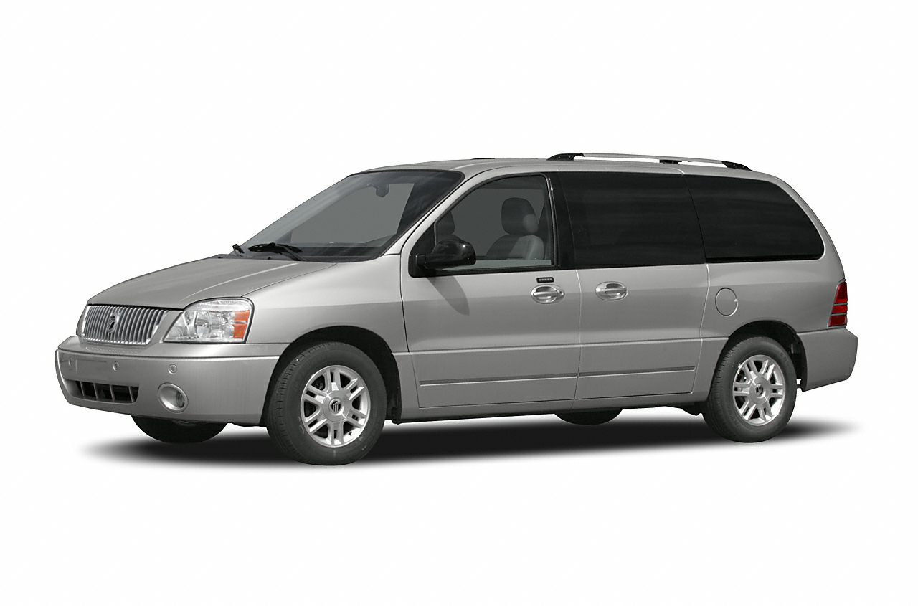
Used OEM MERCURY Parts
Notes:
Mercury is a defunct division of the American automobile manufacturer Ford Motor Company. Marketed as an entry-level premium brand for nearly its entire existence, Mercury was created in 1939 by Edsel Ford to bridge the price gap between the Ford and Lincoln vehicle lines. In a similar context, Buick and Oldsmobile served the same role within General Motors (between Chevrolet and Cadillac) while Mercury competed against the namesake brand of Chrysler(above Plymouth and Dodge, but below Imperial). From 1939 to 2010, Mercury formed half of the Lincoln-Mercury division; under both brands, the combined division created a sales network distinct from Ford. Lincoln-Mercury briefly expanded under the Edsel (1958–1960) and Merkur(1985–1989) brands. To reduce development and production costs, Mercury vehicles shared manufacturing commonality with either Ford or Lincoln (or both), serving as counterparts for vehicles from both divisions.

Slide 32
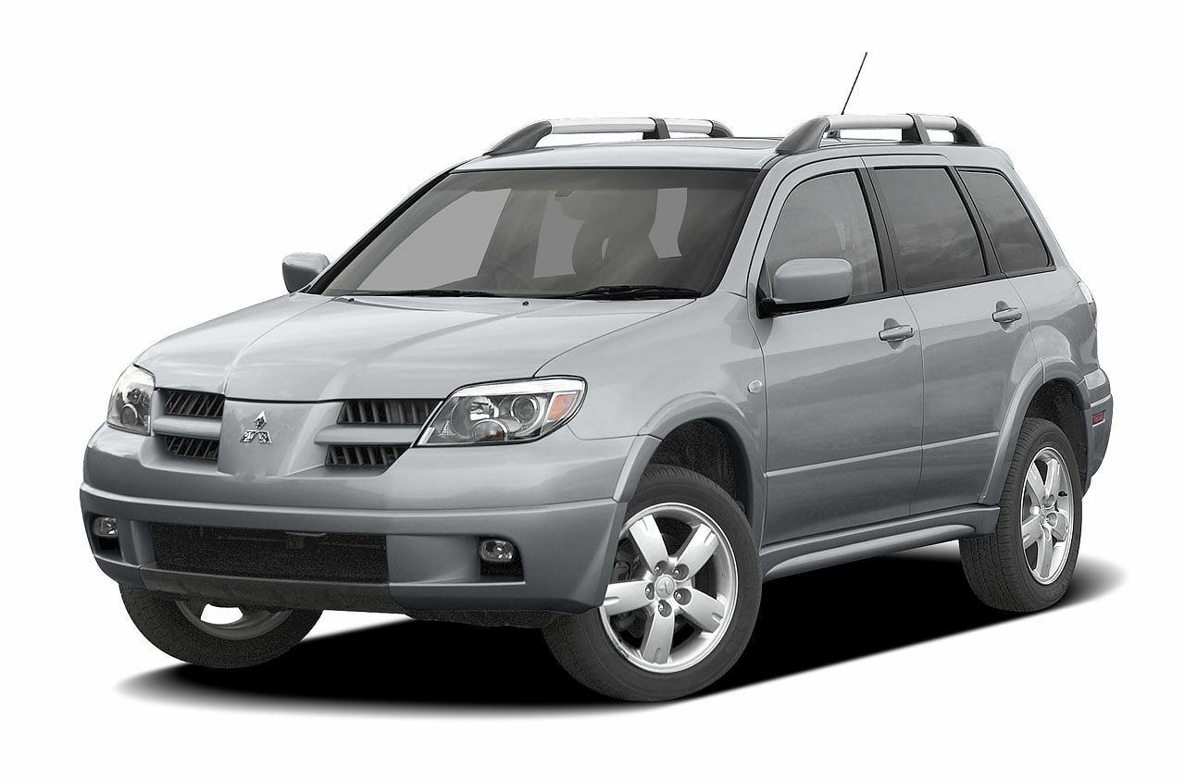
Used OEM MITSUBISHI Parts
Notes:
Mitsubishi Motors Corporation is a Japanese multinationalautomotive manufacturer headquartered in Minato, Tokyo, Japan. In 2011, Mitsubishi Motors was the sixth-biggest Japanese automaker and the nineteenth-biggest worldwide by production. From October 2016 onwards, Mitsubishi has been one-third (34%) owned by Nissan, and thus a part of the Renault–Nissan–Mitsubishi Alliance. Besides being part of the Renault–Nissan–Mitsubishi Alliance, it is also a part of Mitsubishi keiretsu, formerly the biggest industrial group in Japan, and the company was originally formed in 1970 from the automotive division of Mitsubishi Heavy Industries. Mitsubishi Fuso Truck and Bus Corporation, which builds commercial grade trucks, buses and heavy construction equipment, was formerly a part of Mitsubishi Motors, but is now separate from Mitsubishi Motors, and is owned by the German automotive corporation Daimler AG (though Mitsubishi continues to own a small stake).

Slide 33
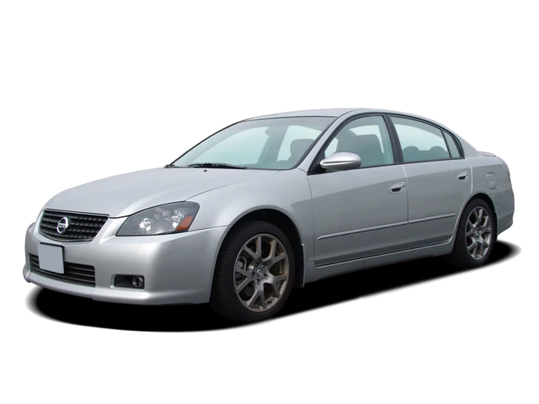
Used OEM NISSAN Parts
Notes:
Nissan Motor Co., Ltd usually shortened to Nissan is a Japanese multinationalautomobile manufacturer headquartered in Nishi-ku, Yokohama. The company sells its cars under the Nissan, Infiniti, and Datsun brands with in-house performance tuning products labelled Nismo. The company traces its name to the Nissan zaibatsu, now called Nissan Group.
Since 1999, Nissan has been part of the Renault–Nissan–Mitsubishi Alliance, a partnership between Nissan of Japan, Mitsubishi Motors of Japan and Renaultof France. As of 2013, Renault holds a 43.4% voting stake in Nissan, while Nissan holds a 15% non-voting stake in Renault. From 2009 to 2017 Carlos Ghosn served as CEO of both companies. In February 2017 Ghosn announced he would step down as CEO of Nissan on 1 April 2017, while remaining chairman of the company. On 19 November 2018, Ghosn was fired as chairman following his arrest for the alleged underreporting of his income to Japanese financial authorities.

Slide 34
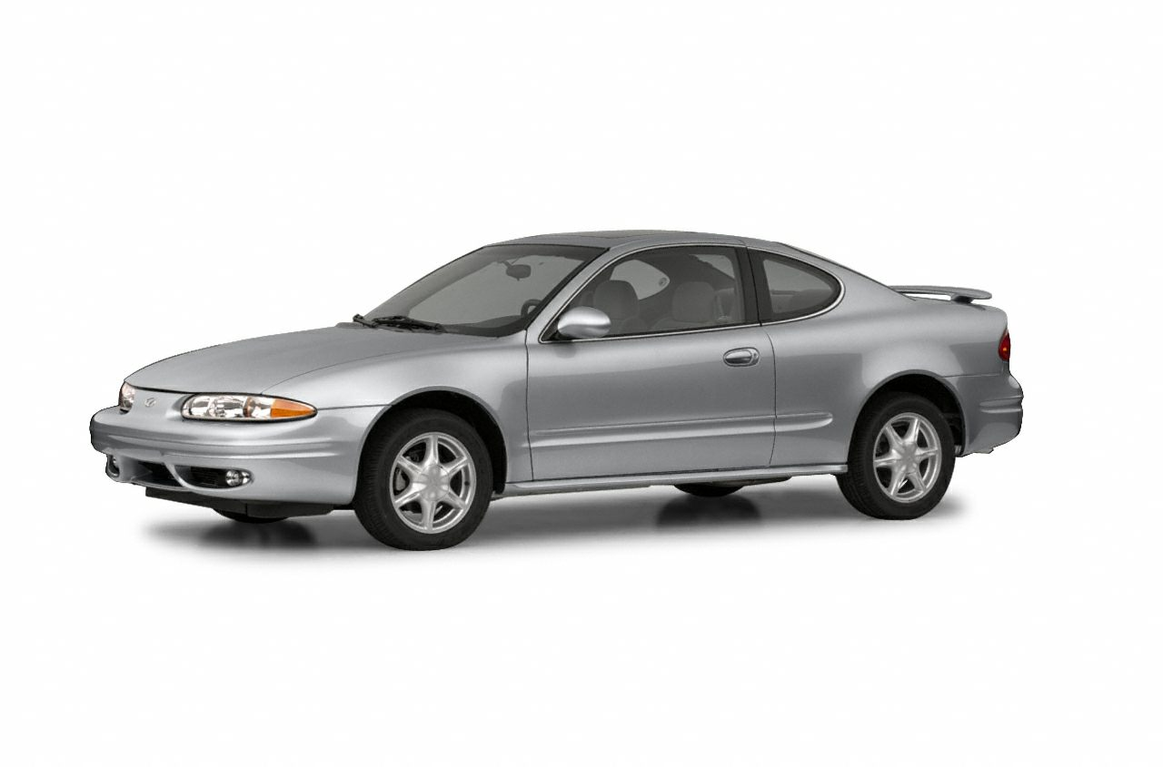
Used OEM OLDSMOBILE Parts
Notes:
Oldsmobile was a brand of American automobiles produced for most of its existence by General Motors. Olds Motor Vehicle Co. was founded by Ransom E. Olds in 1897. It produced over 35 million vehicles, including at least 14 million built at its Lansing, Michigan factory. During its time as a division of General Motors, it slotted in the middle of GM's five divisions (above Pontiac but below Buick), and was noted for its testing of groundbreaking technology and designs, most notably the "Rocket V8" engine. In 1985, over 1 million Oldsmobiles were sold, but by the 1990s the division was tasked with competing with import brands. When it was shut down in 2004, Oldsmobile was the oldest surviving American automobile marque, and one of the oldest in the world, after Peugeot, MAN and Tatra. Oldsmobiles were first manufactured by the Olds Motor Vehicle Co. in Lansing, Michigan, a company founded by Ransom E. Olds in 1897. In 1902, the company produced 635 cars, making it the first high-volume gasoline-powered automobile manufacturer. Oldsmobile became the top selling car company in the United States for a few years around 1903-4. Ransom Olds left the company in 1904 because of a dispute and formed the REO Motor Car Company.

Slide 35
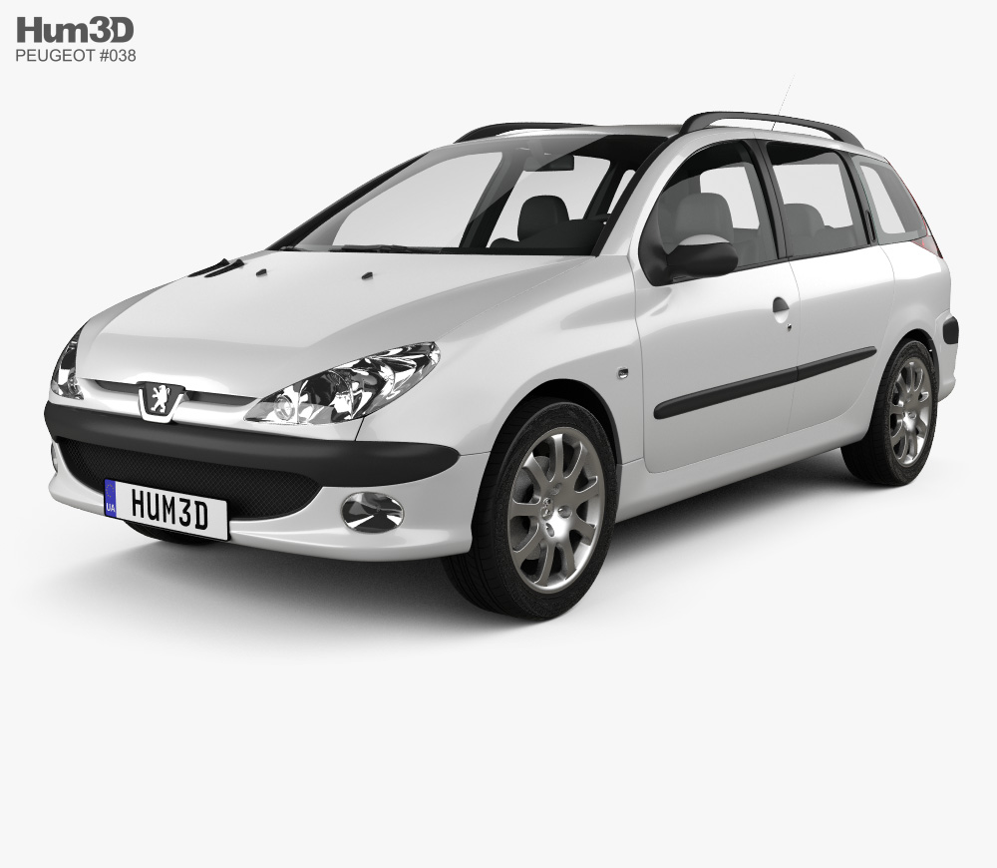
Used OEM PEUGEOT Parts
Notes:
Peugeot is a French automotive manufacturer, part of Groupe PSA. The family business that preceded the current Peugeot company was founded in 1810. Armand Peugeot built the company's first car, an unreliable steam tricycle, in collaboration with Léon Serpollet in 1889; this was followed in 1890 by an internal combustion car with a Panhard-Daimler engine.[8] Due to family discord, Armand Peugeot founded the Société des Automobiles Peugeot, in 1896 .In 2014 this company and its shareholders are planned to do the re-investments when the French Government and Dongfeng motors have bought 14 percentages of the shares each of Peugeot Company. Peugeot had archived so many awards for its models such as “European Car of the Year”. In the years of 2013 and 2014 Peugeot has achieved the second rank in lowest CO2 secretion among the European continents automobile brands. For example of Peugeot’s reliabilities we can see the Peugeot’s 1950s and 1960s car still being used by people in Africa and in and Cuba, in those places this brand has being called as “The lion” for long. Not only these proudest things but also Peugeot have another proudest thing that its model Peugeot Sport has won five times World Rally Championship.

Slide 36
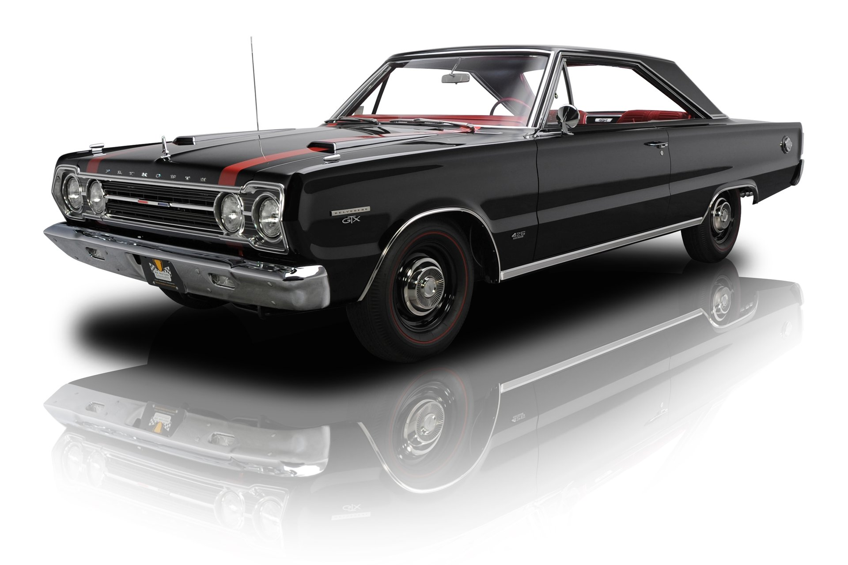
Used OEM PLYMOUTH Parts
Notes:
Plymouth was a brand of automobiles based in the United States, produced by the Chrysler Corporation and its successor DaimlerChrysler. The brand first appeared in 1928 in the United States to compete in what was then described as the "low-priced" market segment dominated by Chevrolet and Ford. Plymouth was the high-volume seller for the automaker until the late 1990s. The brand was withdrawn from the marketplace in 2001. The Plymouth models that were produced up to then were either discontinued or rebranded as Chrysler or Dodge. The Plymouth automobile was introduced at Madison Square Garden on July 7, 1928.[1] It was Chrysler Corporation's first entry in the low-priced field previously dominated by Chevrolet and Ford. Plymouths were initially priced higher than the competition, but offered standard features such as internal expanding hydraulic brakes that Ford and Chevrolet did not provide. Plymouths were originally sold exclusively through Chrysler dealerships, offering a low-cost alternative to the upscale Chrysler-brand cars.

Slide 37
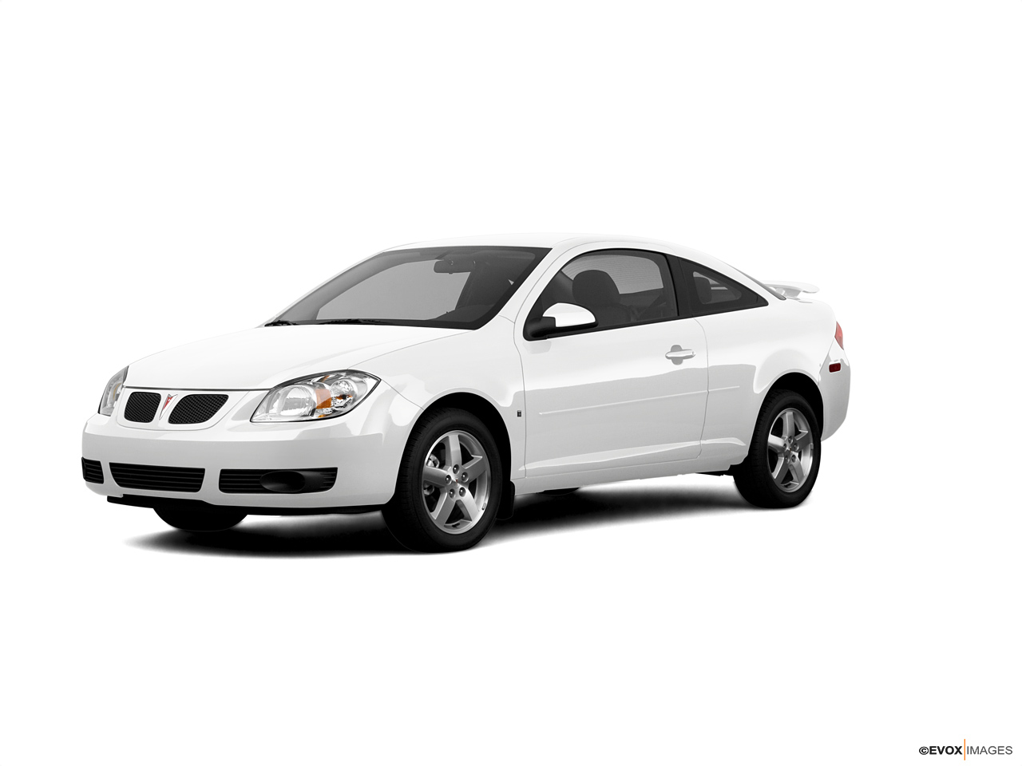
Used OEM PONTIAC Parts
Notes:
During the periods of 1980s Chrysler has launched their K-Car and had the successful sales record on that, so General Motors were in a position to launch a competitor for the Chrysler model and General Motors has launched Pontiac’s brand model called “Fiero” in 1984 and it was a successful model too. Unfortunately in 2009, General Motors has announced that they are going to stop the manufacturing under the Pontiac brand and they are going to focus on other subsidiaries such as Cadillac and Buick. The last vehicle was built in January 2010 under the Pontiac brand. However Pontiac was a very popular vehicle in all over the world particularly in Canada.

Slide 38
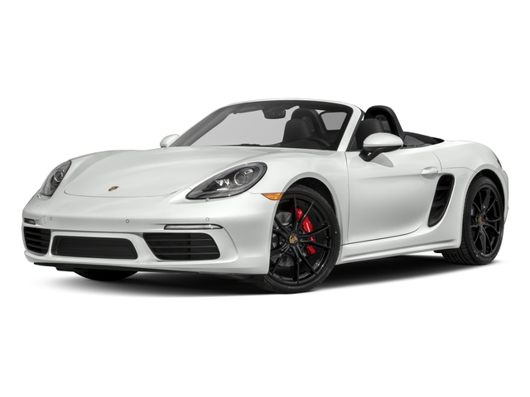
Used OEM PORSCHE Parts
Notes:
PORSCHE is a German automobile manufacturer specializing in high-performance sports cars, SUVs and sedans. Porsche AG is headquartered in Stuttgart, and is owned by Volkswagen AG, which is itself majority-owned by Porsche Automobil Holding SE. Porsche's current lineup includes the 718 Boxster/Cayman, 911, Panamera, Macan and Cayenne. Ferdinand Porsche founded the company called "Dr. Ing. h. c. F. Porsche GmbH" in 1931, Initially, the company offered motor vehicle development work and consulting,[3] but did not build any cars under its own name. One of the first assignments the new company received was from the German government to design a car for the people, that is a "Volkswagen". Porsche has two subsidiaries those are Bertrandt Ag which is a consultancy of German Engineering and Design and the other one is Mieschke Hofmann und Partner which shares of more than 80 percentages is owned by Porsche. Porsche has more than one plants across the Germany one is in Stuttgart and other one is in Leipzig where the models called “Cayenne” and “Panamera” are been made. In 2008 Porsche has totally sold more than 98000 cars within Germany and worldwide.in the recent times this brand tastes the extreme success in the sales.

Slide 39
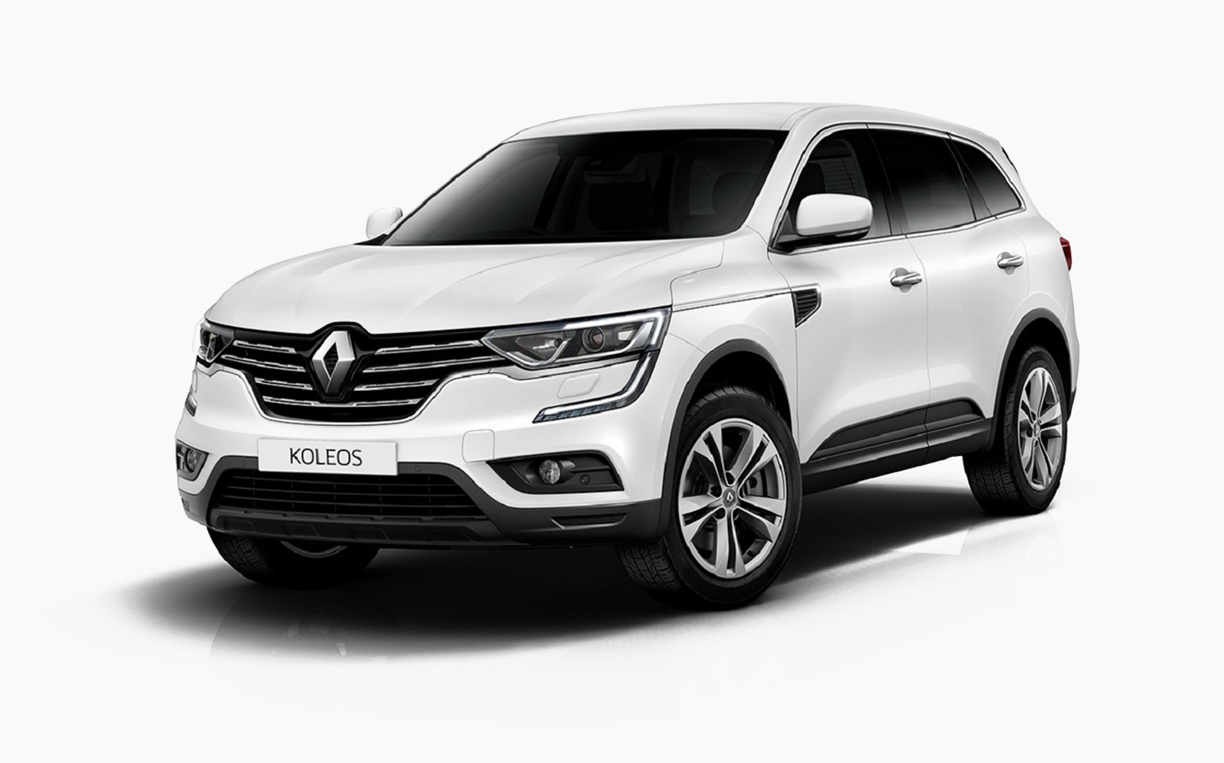
Used OEM RENAULT Parts
Notes:
RENAULT is a French multinational automobile manufacturer established in 1899.The company produces a range of cars and vans, and in the past has manufactured trucks, tractors, tanks, buses/coaches and autorail vehicles. Renault’s brands vehicles are can be seen in any part of the world in nowadays. In the beginning of the year 2000, Renault has focusing on the heavy vehicle manufacturing and they have even stopped it and they have started again to focus on their successful models like mid-range vehicles for the common people. In 2013 the Renault was grabbed the eleventh place in the biggest automobile company I worldwide and this ranking has been done by OICA (International Organization of Motor Vehicle Manufacturer) based on the production capacity and also this brand’s sales were headed more than 50 percentage from the outside of the European continent: this can be also reason for the ranking. Renault model vehicles have won so many awards.

Slide 40
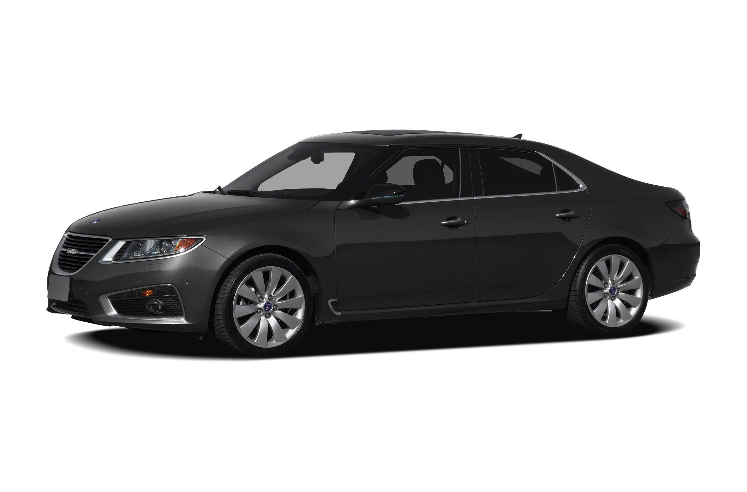
Used OEM SAAB Parts
Notes:
Saab Automobile AB was a manufacturer of automobiles that was founded in Sweden in 1945 when its parent company, SAAB AB, began a project to design a small automobile. The first production model, the Saab 92, was launched in 1949. In 1968 the parent company merged with Scania-Vabis, and ten years later the Saab 900 was launched, in time becoming Saab's best-selling model. In the mid-1980s the new Saab 9000 model also appeared. In 1989, the automobile division of Saab-Scania was restructured into an independent company, Saab Automobile AB. The American manufacturer General Motors (GM) took 50 percent ownership with an investment of US$600 million. Two well-known models to come out of this period were the Saab 9-3and the Saab 9-5. Then in 2000, GM exercised its option to acquire the remaining 50 percent for a further US$125 million; so turning Saab Automobile into a wholly owned GM subsidiary. In 2010 GM sold Saab Automobile AB to the Dutch automobile manufacturer Spyker Cars N.V. After Saab started their “92” project then they has designed few models in cars but in all of their models we could see the resemblance of their aviation designs. In 1955 they have redesigned the “92” model and it renamed as “93”. The recreation has done by the major replacement which was about cylinders: it has been upgraded to 3 cylinders in the “93” model. After several years passed, Saab was in a need of a large model than their existing vehicles and in 1967 they have launched their model called “Saab 99” and it has fulfilled their need so.

Slide 41
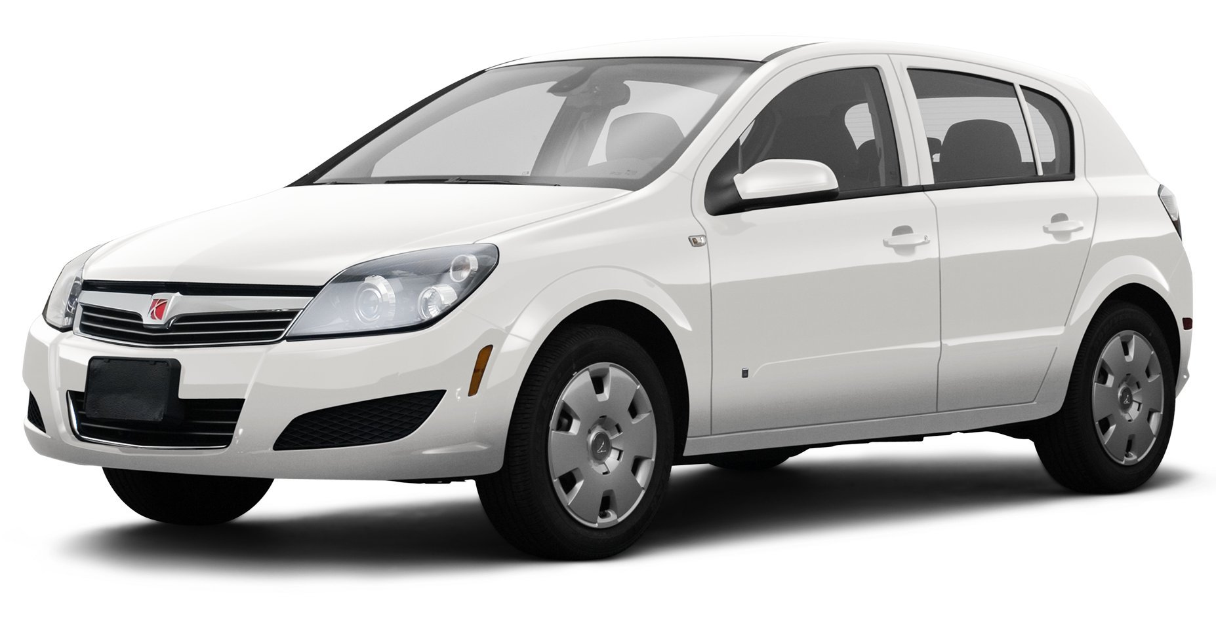
Used OEM SATURN Parts
Notes:
The Saturn Corporation, also known as Saturn LLC, was an American automobile manufacturer, a registered trademark established on January 7, 1985, as a subsidiary of General Motors. The company marketed itself as a "different kind of car company" and operated somewhat independently from its parent company for a time with its own assembly plant in Spring Hill, Tennessee, unique models, and a separate retailer network, and was GM's attempt to compete with Japanese automakers.
Originally, the company's products used a dedicated platform called the Z-body and a dedicated engine, the 1.9 L Saturn I4 engine, and a dedicated plant in Spring Hill, Tennessee. All of the original Saturns featured dent-resistant plastic body panels which were also touted as allowing the company to change the look of the vehicles readily. However, in practice, the company did not often take advantage of this capability.

Slide 42
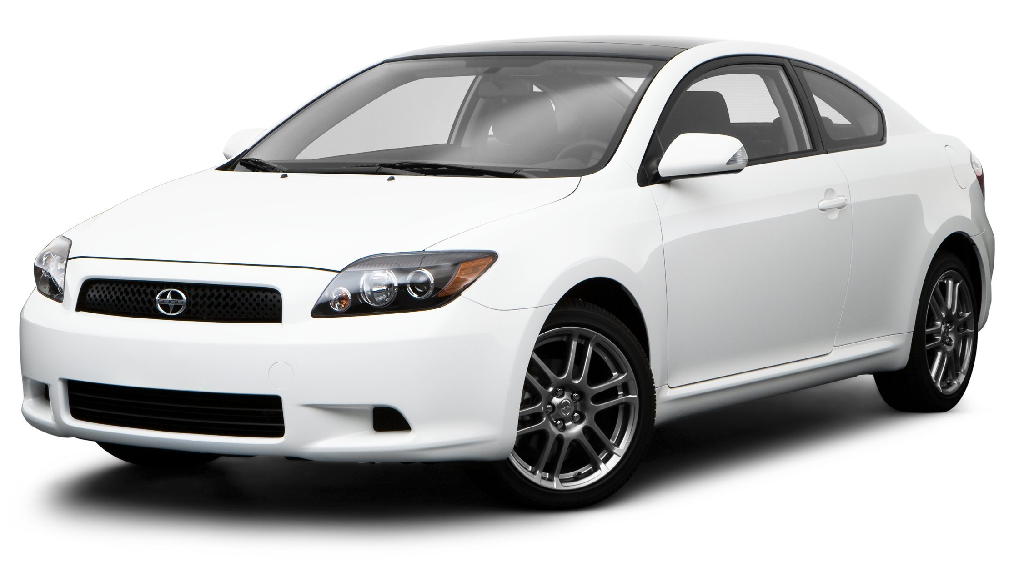
Used OEM SCION Parts
Notes:
Scion is a discontinued marque of Toyota that started in 2003. It was designed as an extension of its efforts to appeal towards younger customers.
Scion had five models in 2014: the second-generation tC, a 3-door liftback based on the European-marketed Toyota Avensis sedan; the second-generation xB, a 5-door box-shaped compact wagon sold as the Toyota Corolla Rumion in the Japanese market the iQ, an ultra-compact city car first going on sale in the western United States in December 2011 the xD, a 5 door-subcompact car that is sold in Japan as the second generation Toyota ist, which is based on the Yaris platform with the tenth-generation Corolla's engine; and a rear-wheel drive sport car, the FR-S.
Scion offered about 150 different accessories other after-market companies through the Optōmize Scion program offer to add other accessories, as well. For example, one can add a subwoofer as well as different types of decals. The tC had offered an optional supercharger to increase power from 161 to 200 hp (120 to 150 kW), but this option was since discontinued in 2007 due to early failure of the bearings inside the centrifugal blower. All accessories are sold individually, and do not require special packages. However, some options, such as Ground Effects, do prevent other accessories (such as mud flaps) from being installed.

Slide 43
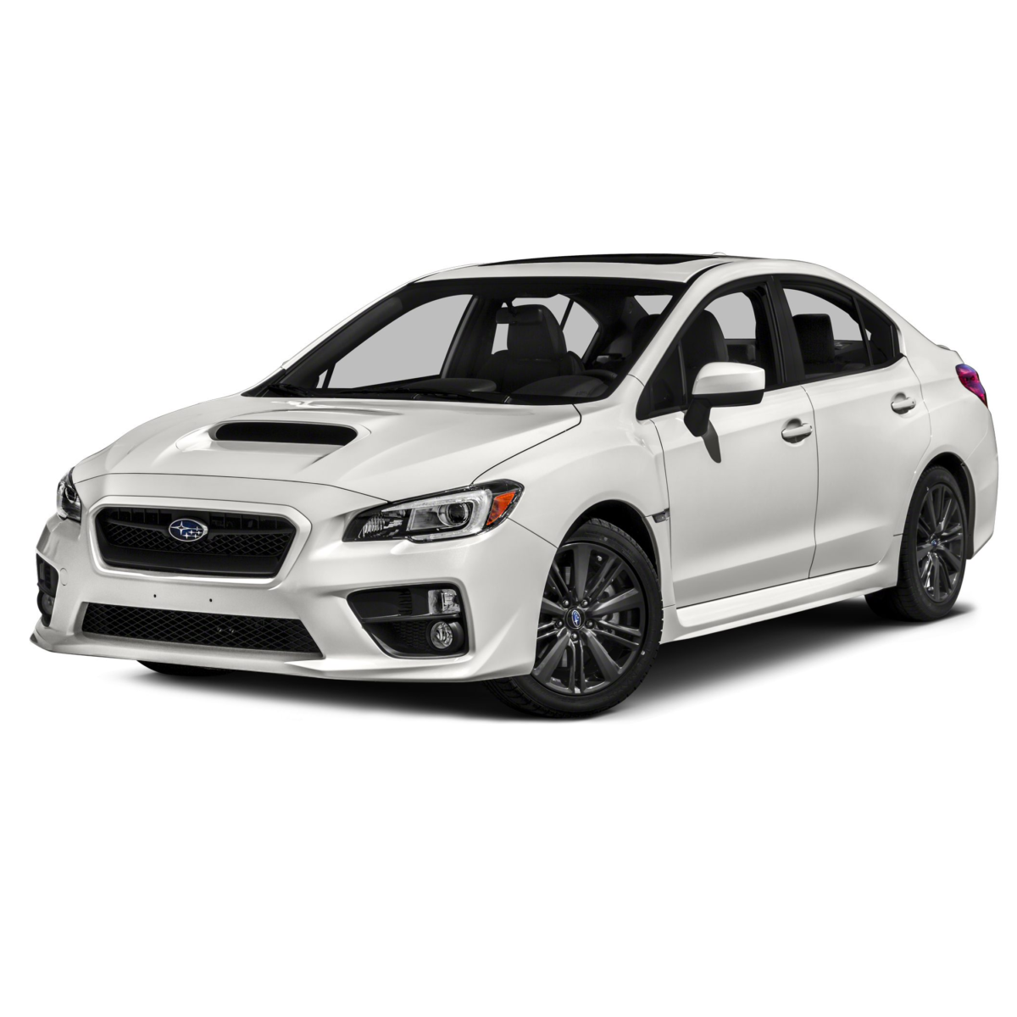
Used OEM SUBARU Parts
Notes:
Subaru is the automobile manufacturing division of Japanese transportation conglomerate Subaru Corporation (formerly known as Fuji Heavy Industries), the twenty-second largest automaker by production worldwide in 2012.
Subaru cars are known for their use of a boxer engine layout in most vehicles above 1500 cc. The Symmetrical All Wheel Drive drive-train layout was introduced in 1972. The flat/boxer engine and all-wheel-drive became standard equipment for mid-size and smaller cars in most international markets by 1996, and is now standard in most North American market Subaru vehicles. The lone exception is the BRZ, introduced in 2012 via a partnership with Toyota, which uses the boxer engine but instead uses a rear-wheel-drive structure. Subaru also offers turbocharged versions of their passenger cars, such as the Impreza WRX and previously the Legacy GT and Forester XT.

Slide 44
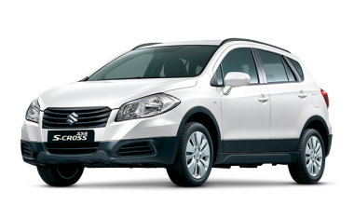
Used OEM SUZUKI Parts
Notes:
Suzuki Motor Corporation is a Japanese multinational corporation headquartered in Minami-ku, Hamamatsu. Suzuki manufactures automobiles, four-wheel drive vehicles, motorcycles, all-terrain vehicles (ATVs), outboard marine engines, wheelchairs and a variety of other small internal combustion engines. In 2016, Suzuki was the eleventh biggest automaker by production worldwide. Suzuki has over 45,000 employees and has 35 production facilities in 23 countries, and 133 distributors in 192 countries. The worldwide sales volume of automobiles is the world's tenth largest, while domestic sales volume is the third largest in the country.
In 1909, Michio Suzuki (1887–1982) founded the Suzuki Loom Works in the small seacoast village of Hamamatsu, Japan. Business boomed as Suzuki built weaving looms for Japan's giant silk industry. In 1929, Michio Suzuki invented a new type of weaving machine, which was exported overseas. The company's first 30 years focused on the development and production of these machines.

Slide 45
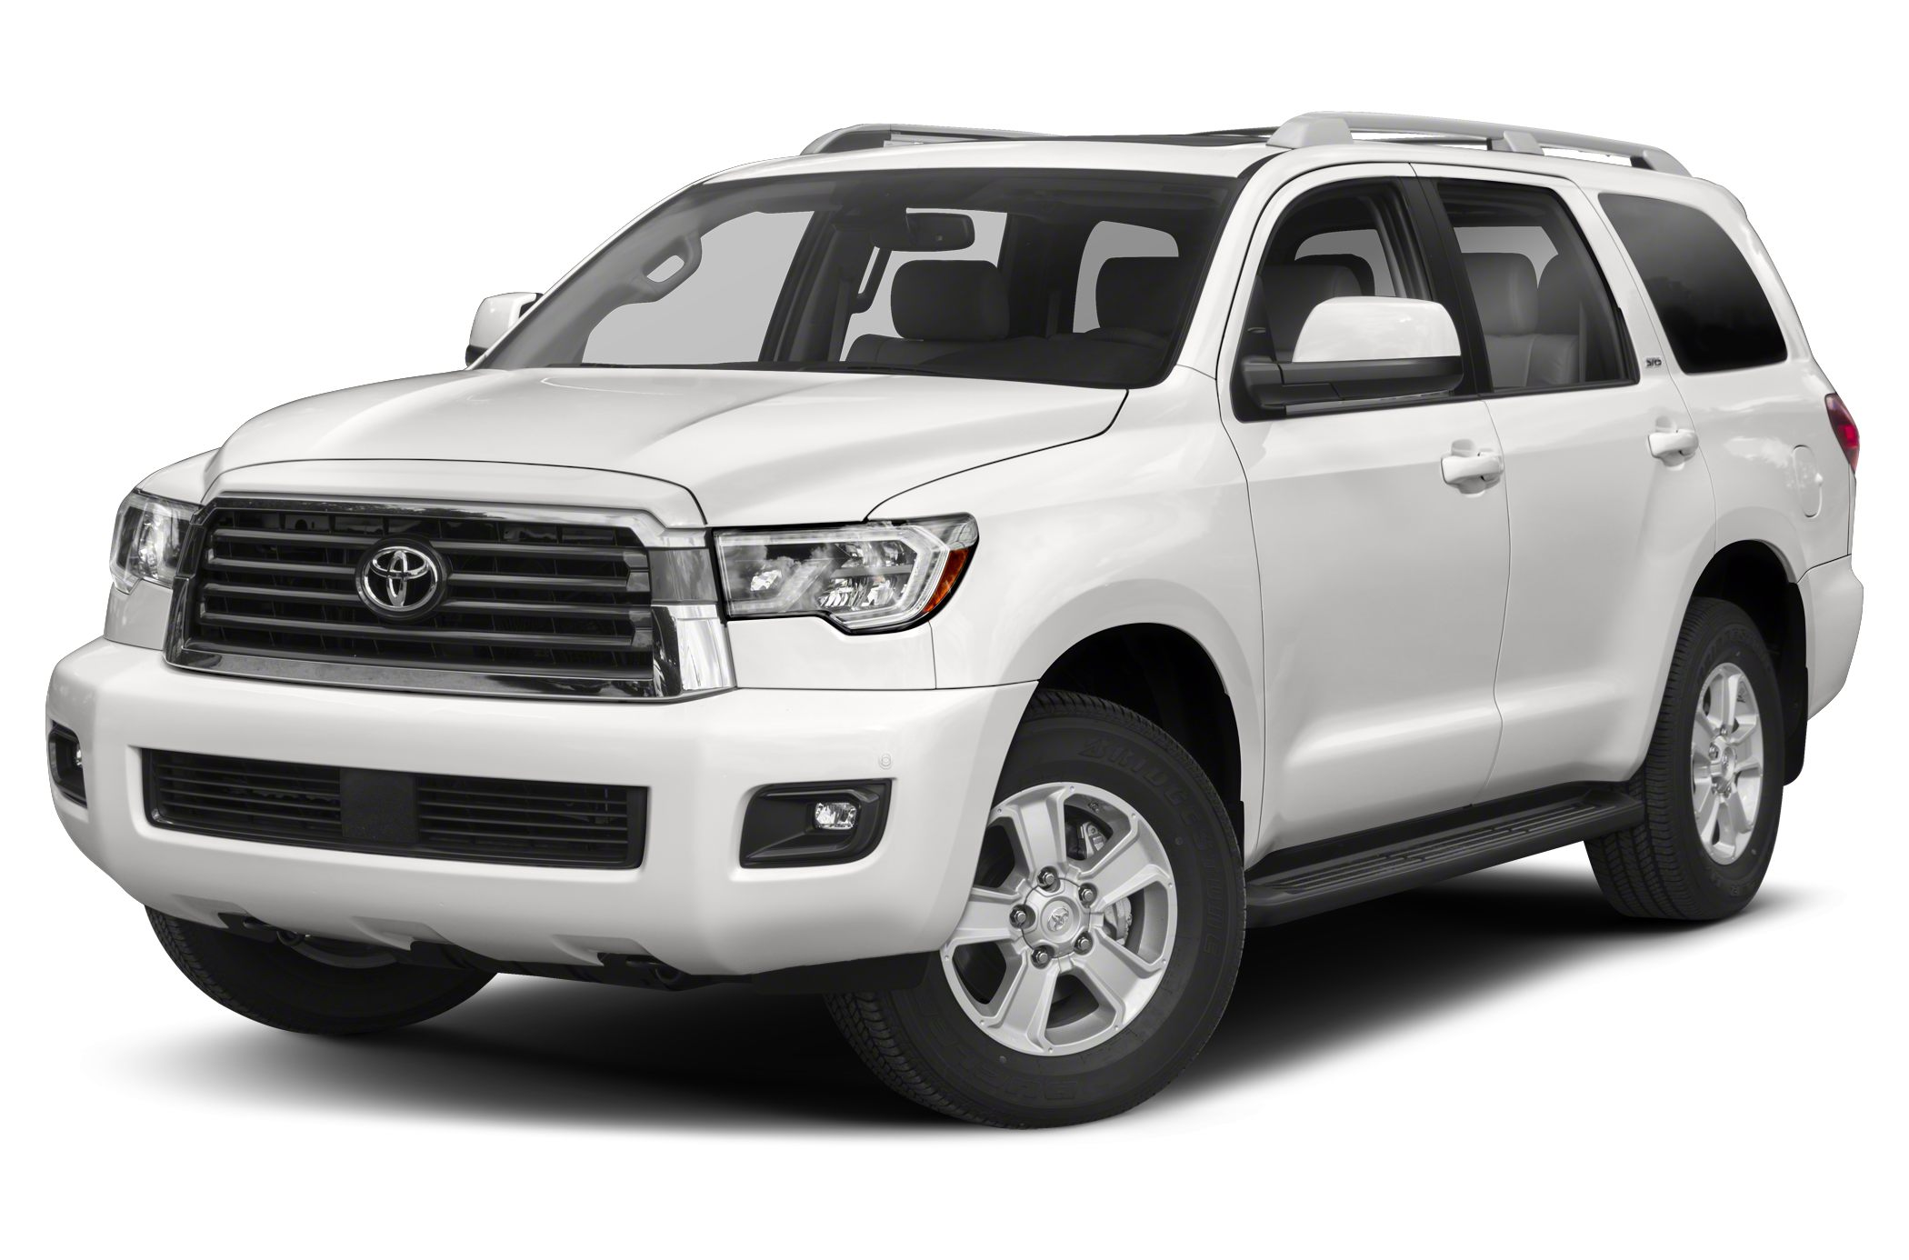
Used OEM TOYOTA Parts
Notes:
Toyota Motor Corporation is a Japanese multinational automotive manufacturer headquartered in Toyota City, Aichi, Japan. In 2017, Toyota's corporate structure consisted of 364,445 employees worldwide and, as of September 2018, was the sixth-largest company in the world by revenue. As of 2017, Toyota is the world's second-largest automotive manufacturer. Toyota was the world's first automobile manufacturer to produce more than 10 million vehicles per year which it has done since 2012, when it also reported the production of its 200-millionth vehicle. As of July 2014, Toyota was the largest listed company in Japan by market capitalization (worth more than twice as much as #2-ranked SoftBank) and by revenue.
In the 1990s, Toyota began to branch out from producing mostly compact cars by adding many larger and more luxurious vehicles to its lineup, including a full-sized pickup, the T100 (and later the Tundra), several lines of SUVs, a sport version of the Camry, known as the Camry Solara. They would also launch newer iterations of their sports cars, namely the MR2, Celica, and Supra during this era.
With a major presence in Europe, due to the success of Toyota Team Europe, the corporation decided to set up Toyota Motor Europe Marketing and Engineering, TMME, to help market vehicles in the continent. Two years later, Toyota set up a base in the United Kingdom, TMUK, as the company's cars had become very popular among British drivers. Bases in Indiana, Virginia, and Tianjin were also set up. In 1999, the company decided to list itself on the New York and London Stock Exchanges.

Slide 46
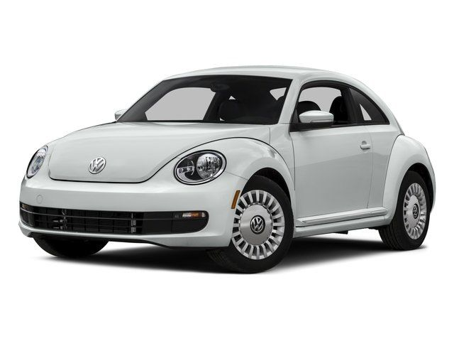
Used OEM VOLKSWAGEN Parts
Notes:
Volkswagen is a German automaker founded on 28 May 1937 by the German Labour Front, and headquartered in Wolfsburg. It is the flagship marque of the Volkswagen Group, the largest automaker by worldwide sales in 2016 and 2017 The group's main market is in China, which delivers 40% of its sales and profits.
Volkswagen was established in 1937 by the German Labour Front (Deutsche Arbeitsfront) in Berlin.[6] In the early 1930s cars were a luxury: most Germans could afford nothing more elaborate than a motorcycle. Only one German out of 50 owned a car. Seeking a potential new market, some car makers began independent "people's car" projects – the Mercedes 170H, Adler AutoBahn, Steyr 55, and Hanomag 1.3L, among others.

Slide 47
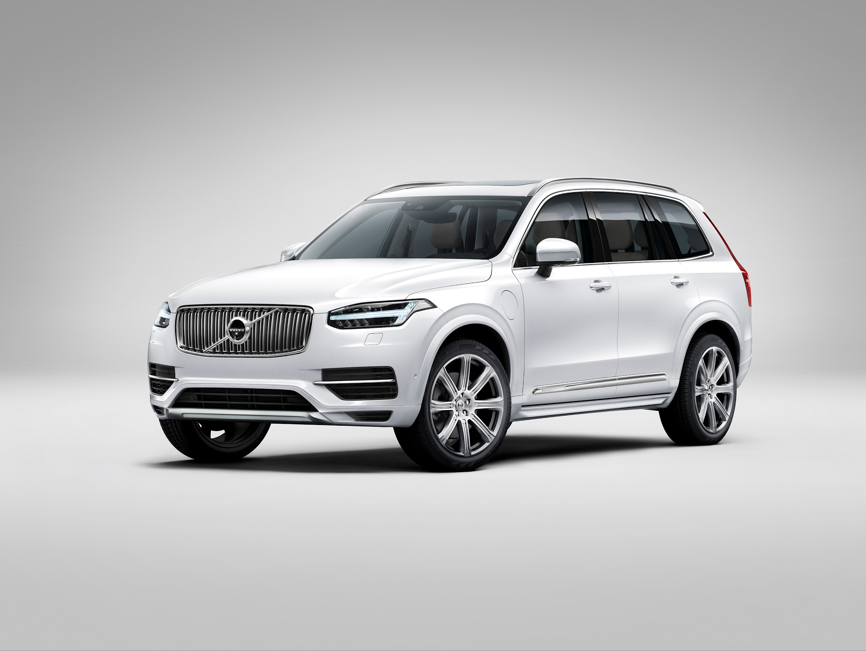
Used OEM VOLVO Parts
Notes:
The Volvo Group is a Swedish multinational manufacturing company headquartered in Gothenburg. While its core activity is the production, distribution and sale of trucks, buses and construction equipment, Volvo also supplies marine and industrial drive systems and financial services. In 2016, it was the world's second largest manufacturer of heavy-duty trucks.
The brand name Volvo was originally registered as a trademark in May 1911 with the intention to be used for a new series of SKF ball bearings. It means "I roll" in Latin, conjugated from "volvere". The idea was short-lived, and SKF decided to simply use its initials as the trademark for all its bearing products.
In 1924, Assar Gabrielsson, an SKF sales manager, and a KTH Royal Institute of Technology educated engineer Gustav Larson, the two founders,[clarification needed] decided to start construction of a Swedish car. They intended to build cars that could withstand the rigors of the country's rough roads and cold temperatures.

Slide 48
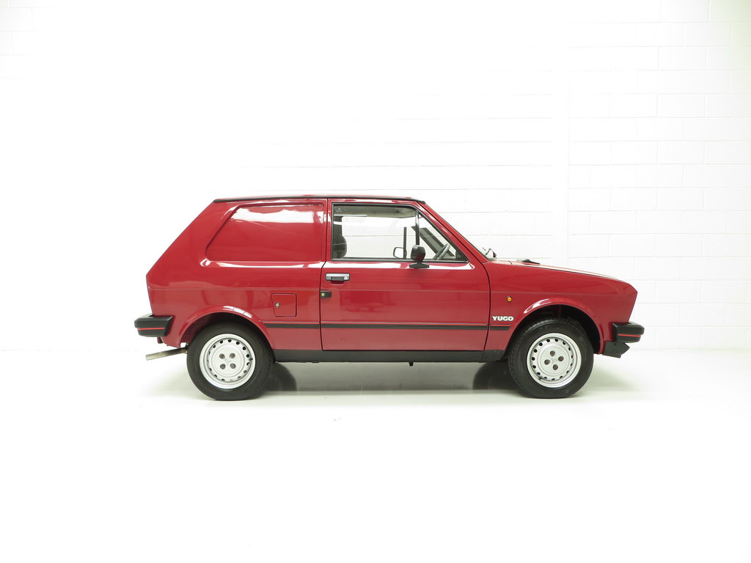
Used OEM YUGO Parts
Notes:
The Yugo, also marketed as the Zastava Koral and Yugo Koral, is a supermini hatchback formerly manufactured by Zastava Automobiles, at the time a Yugoslav corporation.Originally designed in Italy, as a variant of the Fiat 127, the first Yugo prototype was manufactured on 2 July 1977. Series production started on 28 November 1980. The Zastava Koral, a facelifted model, was marketed until 11 November 2008, after production of 794,428 cars.

Slide 49
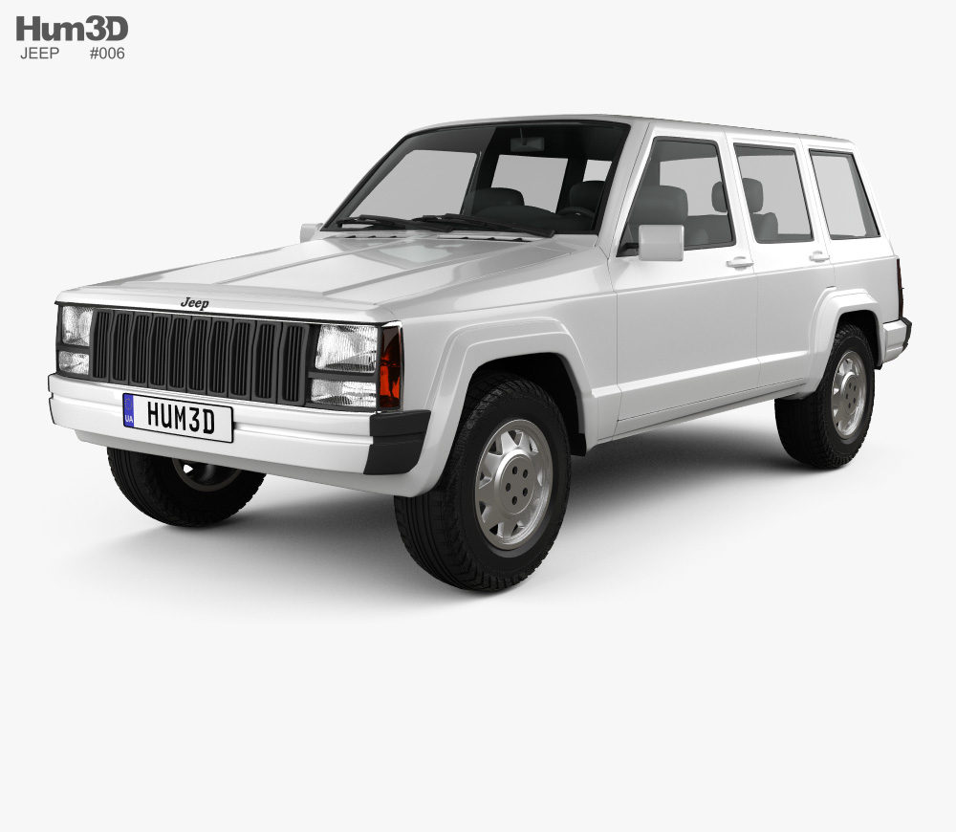
Used OEM JEEP Parts
Notes:
Jeep is a brand of American automobiles that is a division of FCA US LLC (formerly Chrysler Group, LLC), a wholly owned subsidiary of the Italian-American corporation Fiat Chrysler Automobiles. Jeep has been a part of Chrysler since 1987, when Chrysler acquired the Jeep brand, along with remaining assets, from its previous owner: American Motors Corporation (AMC).
Jeep's current product range consists solely of sport utility vehicles and off-road vehicles, but has also included pickup trucks and roadsters in the past; Jeep will return to the pickup truck market in early 2019. Some of Jeep's vehicles—such as the Grand Cherokee—reach into the luxury SUV segment, a market segment the Wagoneer is considered to have created. Jeep sold 1.4 million SUVs globally in 2016, up from 500,000 in 2008, two-thirds of which in North America, and was Fiat-Chrysler's best selling brand in the U.S. during the first half of 2017.[8] In the U.S. alone, over 2400 dealerships hold franchise rights to sell Jeep-branded vehicles, and if Jeep were spun off into a separate company, it is estimated to be worth between $22 and $33.5 billion—slightly more than all of FCA (US).

Slide 50
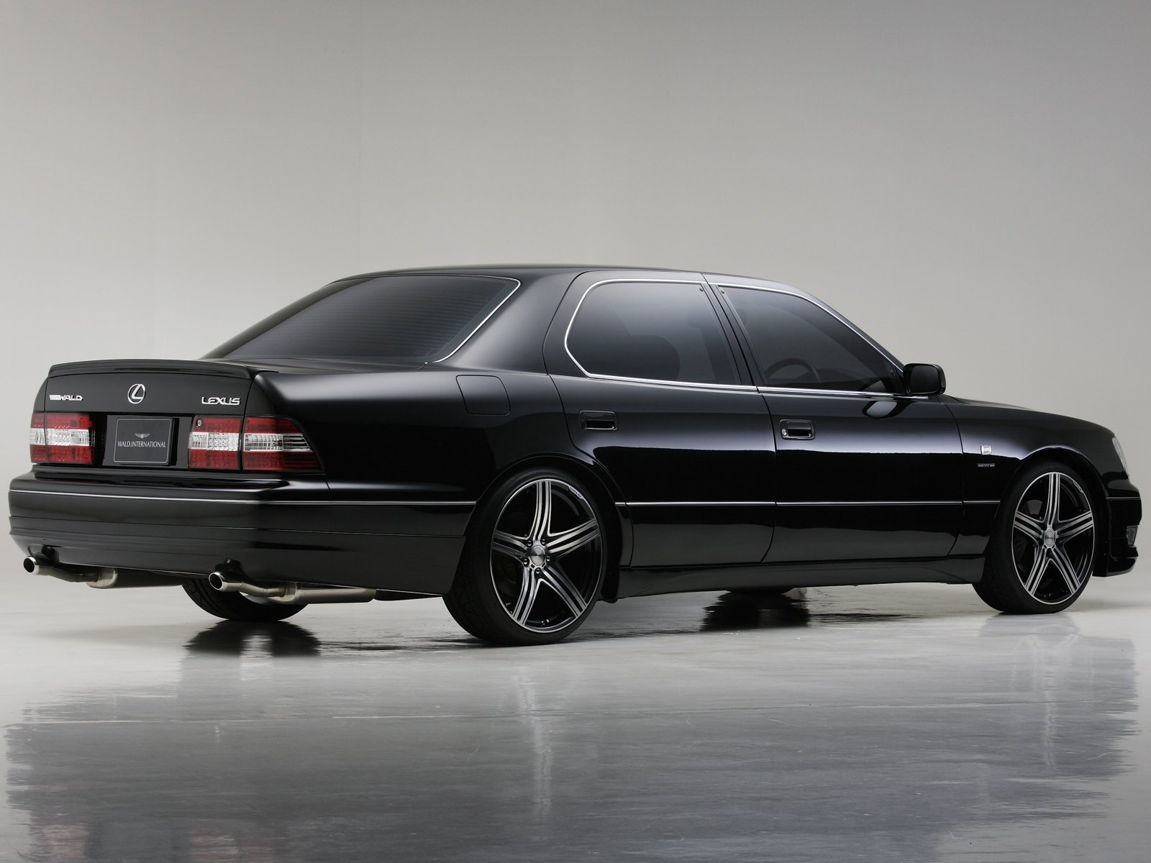
Used OEM INTERNATIONAL Parts

Slide 51

Used OEM ALLARD Parts
Notes:
Allard Motor Company Limited was a London-based low-volume car manufacturer founded in 1945 by Sydney Allard in small premises in Clapham, south-west London. Car manufacture almost ceased within a decade. It produced approximately 1900 cars before it became insolvent and ceased trading in 1958.[citation needed] Before the war, Allard supplied some replicas of a Bugatti-tailed special of his own design from Adlards Motors in Putney.
Allards featured large American V8 engines in a light British chassis and body, giving a high power-to-weight ratio and foreshadowing the Sunbeam Tiger and AC Cobra of the early 1960s. Cobra designer Carroll Shelby and Chevrolet Corvette chief engineer Zora Arkus-Duntov both drove Allards in the early 1950s.

Slide 52

Used OEM ALPINA Parts
Notes:
Alpina Burkard Bovensiepen GmbH & Co. KG is an automobile manufacturing company based in Buchloe, in the Ostallgäu district of Bavaria, Germany that develops and sells high-performance versions of BMW cars.
Alpina works closely with BMW and their processes are integrated into BMW's production lines, thus Alpina is recognized by the German Ministry of Transport as an automobile manufacturer, in contrast to other performance specialists which are aftermarket tuners. For instance, the Alpina B7 is produced at the same assembly line in Dingolfing, Germany (BMW Plant Dingolfing), as BMW's own 7 Series. The B7's twin-turbo 4.4-litre V8 is assembled by hand at Alpina's facility in Buchloe, Germany, before being shipped to BMW for installation, and the assembled vehicle is then sent back to Alpina for finishing touches.

Slide 53

Used OEM ARIEL Parts
Notes:
The Ariel is a road legal high performance sports car made by the Ariel Motor Company based in Crewkerne, Somerset, England, and under licence in North America by TMI Autotech, Inc. at Virginia International Raceway in Alton, Virginia.
There have been eight Ariel Atom generations to date: Ariel Atom, Ariel Atom 2, Ariel Atom 3 (including the Ariel Atom 3 Mugen Limited Edition and Honda Racing Edition – of which only one was made) Ariel Atom 3.5, Ariel Atom 3S, Ariel Spec:Race Atom, Ariel Atom 500 V8 Limited Edition (only 25 to be made), and the Ariel Atom 4. The limited production Ariel Atom 500 V8 featured a 373 kW (500 bhp; 507 PS) V8 engine. The all new Ariel Atom 4 is the latest Atom featuring a new turbocharged 2.0l engine that is used in the Honda Civic Type R with 3-stage boost.
The Ariel Atom features a prominently visible chassis (i.e., an exoskeleton, no roof or windows, a small optional windscreen) and a drag coefficient of 0.40.

Slide 54

Used OEM ASTON MARTIN Parts
Notes:
Aston Martin Lagonda Global Holdings plc is a British independent manufacturer of luxury sports cars and grand tourers. It was founded in 1913 by Lionel Martin and Robert Bamford. Steered from 1947 by David Brown, it became associated with expensive grand touring cars in the 1950s and 1960s, and with the fictional character James Bond following his use of a DB5 model in the 1964 film Goldfinger. Their sports cars are regarded as a British cultural icon. Aston Martin has held a Royal Warrant as purveyor of motorcars to the Prince of Wales since 1982. It has over 150 car dealerships in over 50 countries on six continents, making them a global automobile brand. The company is traded at the London Stock Exchange and is a constituent of the FTSE 250 Index.Aston Martin was founded in 1913 by Lionel Martin and Robert Bamford. The two had joined forces as Bamford & Martin the previous year to sell cars made by Singer from premises in Callow Street, London where they also serviced GWK and Calthorpe vehicles. Martin raced specials at Aston Hill near Aston Clinton, and the pair decided to make their own vehicles. The first car to be named Aston Martin was created by Martin by fitting a four-cylinder Coventry-Simplex engine to the chassis of a 1908 Isotta Fraschini.

Slide 55

Used OEM AUSTIN Parts
Notes:
The Austin Motor Company Limited was a British manufacturer of motor vehicles, founded in 1905 by Herbert Austin. In 1952 it was merged with Morris Motors Limited in the new holding company British Motor Corporation (BMC) Limited, keeping its separate identity. The marque Austin was used until 1987. The trademark is currently owned by SAIC after being transferred from bankrupt subsidiary Nanjing Automotive which had acquired it with MG Rover Group in July 2005.

Slide 56

Used OEM AUSTIN HEALEY Parts
Notes:
Austin-Healey was a British sports car maker established in 1952 through a joint venture between the Austin division of the British Motor Corporation (BMC) and the Donald Healey Motor Company (Healey), a renowned automotive engineering and design firm. Leonard Lord represented BMC and Donald Healey his firm.
BMC merged with Jaguar Cars in 1966 to form British Motor Holdings (BMH). Donald Healey left BMH in 1968 when it merged into British Leyland. Healey then joined Jensen Motors, which had been making bodies for the "big Healeys" since their inception in 1952, and became their chairman in 1972. Austin-Healey cars were produced until 1972 when the 20-year agreement between Healey and Austin came to an end.

Slide 57

Used OEM AVANTI Parts
Notes:
The Avanti II is an American performance sports coupe based on the Studebaker Avanti and marketed through a succession of five different ownership arrangements subsequent to Studebaker's discontinuation of the model. After the closure of Studebaker's South Bend factory on December 20, 1963, cars carrying the Avanti nameplate were initially produced from left-over Studebaker components and later, by the Avanti Motor Company from General Motors and Ford chassis and engines. Very few cars were made before all production ceased in 2006.

Slide 58

Used OEM BENTLEY Parts
Notes:
Bentley Motors Limited is a British manufacturer and marketer of luxury cars and SUVs—and a subsidiary of the Volkswagen Group since 1998.Headquartered in Crewe, England, the company was founded as Bentley Motors Limited by W. O. Bentley in 1919 in Cricklewood, North London—and became widely known for winning the 24 Hours of Le Mans in 1924, 1927, 1928, 1929, 1930, and 2003.Prominent models extend from the historic sports-racing Bentley 4½ Litre and Bentley Speed Six; the more recent Bentley R Type Continental, Bentley Turbo R, and Bentley Arnage; to its current model line—including the Continental Flying Spur, Continental GT, Bentley Bentayga and the Mulsanne—which are marketed worldwide, with China as its largest market as of November 2012.

Slide 59

Used OEM BERKELEY Parts
Notes:
Berkeley Cars The Berkeley automobile was a collaboration between designer Lawrence "Lawrie" Bond and the Berkeley Coachworks factory owned by Charles Panter, which at the time was one of the largest manufacturers of caravans in Europe. It was an ideal project for Berkeley, who had developed considerable skills in the use of Glass-reinforced plastic (GRP), and were looking for something to fill the gaps in the very seasonal caravan market. What Panter and Bond wanted to achieve was "something good enough to win World 750cc races... but cheap, safe, easily repairable and pretty.of Biggleswade, Bedfordshire, England produced economical sporting microcars with motorcycle-derived engines from 322 cc to 692 cc and front wheel drive between 1956 and 1960.

Slide 60

Used OEM BITTER Parts
Notes:
Erich Bitter Automobil GmbH (Bitter) is a premium sports-luxury automobile marque produced in Germany and later Austria. Founder Erich Bitter, a former racing driver turned automobile tuner, importer and ultimately designer began crafting his own vehicles after business ventures with Italian manufacture Intermeccanica ended.
Bitter specialises in rebodying other manufacturer's vehicles and its initial production was between 1973 and 1989, selling vehicles in Europe and the United States. Thereafter, several prototypes followed with an eye on resuming low-volume production, but none of those plans came to fruition until the launch of the Bitter Vero in 2007.

Slide 61

Used OEM BIZZARRINI Parts
Notes:
Bizzarrini S.p.A. was an Italian automotive manufacturer in the 1960s founded by former Alfa Romeo, Ferrari and Iso engineer Giotto Bizzarrini. The company built a small number of highly developed and advanced sport and racing automobiles before failing in 1969. Notable models include the 5300 GT Strada and the P538S.
Originally Prototipi Bizzarrini s.r.l., the name was changed to Bizzarrini S.p.A. in 1966. The Bizzarrini marque has been revived with a number of concept cars in the 2000s.

Slide 62

Used OEM BUGATTI Parts
Notes:
Automobiles Ettore Bugatti was a French car manufacturer of high-performance automobiles, founded in 1909 in the then-German city of Molsheim, Alsace by the Italian-born industrial designer Ettore Bugatti. The cars were known for their design beauty and for their many race victories. Famous Bugattis include the Type 35 Grand Prix cars, the Type 41 "Royale", the Type 57 "Atlantic" and the Type 55 sports car.
The death of Ettore Bugatti in 1947 proved to be the end for the marque, and the death of his son Jean Bugatti in 1939 ensured there was not a successor to lead the factory. No more than about 8,000 cars were made. The company struggled financially, and released one last model in the 1950s, before eventually being purchased for its airplane parts business in 1963. In the 1990s, an Italian entrepreneur revived it as a builder of limited production exclusive sports cars. Today, the name is owned by the Volkswagen Group.

Slide 63

Used OEM CATERHAM Parts
Notes:
Caterham Cars is a British manufacturer of specialist lightweight sports cars established in Caterham, Surrey, with their headquarters in Crawley, Sussex. Their current model, the Caterham 7 (or Seven), originally launched in 1973, is a direct evolution of the Series 3 Lotus Seven designed by Colin Chapman. In the 1990s the company made the Caterham 21, a two-seater soft top alternative to the MGF and Lotus Elise, (which both sold many more units). A track-only car, the SP/300.R, a joint project with Lola was released for customer testing in 2010 and was scheduled for release in 2013. On 27 April 2011, Team Lotus owner Tony Fernandes announced that he had purchased Caterham.

Slide 64

Used OEM CHECKER Parts
Notes:
Checker Motors Corporation was a Kalamazoo, Michigan-based vehicle manufacturer and tier-one subcontractor that manufactured taxicabs used by Checker Taxi. Checker Motors Corporation was established by Morris Markin in 1922 through a merger of Commonwealth Motors and Markin Automobile Body.
Checker made the iconic American taxi cab, valued by taxicab companies for its durability in heavy use. Special features included wide rear doors, large rear seats and trunks. The company had trouble competing with fleet discounts offered by the larger manufacturers, as well as economies of scale in procuring components. The final models were produced in 1982.

Slide 65

Used OEM DAIMLER Parts
Notes:
The Daimler Company Limited, until 1910, the Daimler Motor Company Limited, was an independent British motor vehicle manufacturer founded in London by H. J. Lawson in 1896, which set up its manufacturing base in Coventry. The company bought the right to the use of the Daimler name simultaneously from Gottlieb Daimler and Daimler-Motoren-Gesellschaft of Cannstatt, Germany. After early financial difficulty and a reorganisation of the company in 1904, the Daimler Motor Company was purchased by Birmingham Small Arms Company (BSA) in 1910, which also made cars under its own name before World War II. In 1933, BSA bought the Lanchester Motor Company and made it a subsidiary of Daimler.
Daimler was awarded a Royal Warrant to provide cars to the British Monarch in 1902; it lost this privilege in the 1950s after being supplanted by Rolls-Royce. Daimler occasionally used alternative technology: the Knight engine which it further developed in the early twentieth century and used from 1909 to 1935, worm gear final drive fitted from 1909 until after the Second World War, and their patented fluid flywheel used in conjunction with a Wilson preselector gearbox from 1930 to the mid-1950s.

Slide 66

Used OEM DATSUN Parts
Notes:
Datsun is an automobile brand owned by Nissan. Datsun's original production run began in 1931. From 1958 to 1986, only vehicles exported by Nissan were identified as Datsun. By 1986 Nissan had phased out the Datsun name, but re-launched it in June 2013 as the brand for low-cost vehicles manufactured for emerging markets.
In 1931, Dat Motorcar Co. chose to name its new small car "Datson", a name which indicated the new car's smaller size when compared to the DAT's larger vehicle already in production. When Nissan took control of DAT in 1934, the name "Datson" was changed to "Datsun", because "son" also means "loss" in Japanese and also to honour the sun depicted in the national flag – thus the name Datsun: Dattosan. Nissan phased out the Datsun brand in March 1986. The Datsun name is internationally well known for the 510, Fairlady roadsters, the Fairlady (S30 240Z, 260Z, 280Z) S130 280ZX coupes, and recently, the Go hatchback.

Slide 67

Used OEM DE TOMASO Parts
Notes:
De Tomaso Modena SpA was an Italian car-manufacturing company. It was founded by the Argentine-born Alejandro de Tomaso (1928–2003) in Modena in 1959. It originally produced various prototypes and racing cars, including a Formula One car for Frank Williams's team in 1970. Most of the funding for the automaker came from de Tomaso's brother-in-law, Armory Haskell Jr, Rowan Industries. In 1971, Ford acquired an 84% stake in De Tomaso from Rowan with Alejandro de Tomaso himself holding the balance. Ford would sell back their stake in the automaker in 1974 to Alejandro.

Slide 68

Used FERRARI Parts
Notes:
Ferrari is an Italian luxury sports car manufacturer based in Maranello. Founded by Enzo Ferrari in 1939 out of Alfa Romeo's race division as Auto Avio Costruzioni, the company built its first car in 1940. However, the company's inception as an auto manufacturer is usually recognized in 1947, when the first Ferrari-badged car was completed.
In 2014, Ferrari was rated the world's most powerful brand by Brand Finance. In June 2018, the 1964 250 GTO became the most expensive car in history, setting an all-time record selling price of $70 million.
Fiat S.p.A. acquired 50% of Ferrari in 1969 and expanded its stake to 90% in 1988. In October 2014 Fiat Chrysler Automobiles N.V. (FCA) announced its intentions to separate Ferrari S.p.A. from FCA; as of the announcement FCA owned 90% of Ferrari. The separation began in October 2015 with a restructuring that established Ferrari N.V. (a company incorporated in the Netherlands) as the new holding company of the Ferrari group and the subsequent sale by FCA of 10% of the shares in an IPO and concurrent listing of common shares on the New York Stock Exchange. Through the remaining steps of the separation, FCA's interest in Ferrari's business was distributed to shareholders of FCA, with 10% continuing to be owned by Piero Ferrari. The spin-off was completed on 3 January 2016.

Slide 69

Used FIAT Parts
Notes:
Fiat Automobiles is an Italian automobile manufacturer, a subsidiary of FCA Italy S.p.A., which is part of Fiat Chrysler Automobiles (previously Fiat S.p.A.). Fiat Automobiles was formed in January 2007 when Fiat reorganized its automobile business, and traces its history back to 1899 when the first Fiat automobile, the Fiat 4 HP, was produced.
Fiat Automobiles is the largest automobile manufacturer in Italy. During its more than century-long history, it remained the largest automobile manufacturer in Europe and the third in the world after General Motors and Ford for over twenty years, until the car industry crisis in the late 1980s. In 2013, Fiat S.p.A. was the second largest European automaker by volumes produced and the seventh in the world, while currently FCA is the world's eighth largest auto maker.
In 1970, Fiat Automobiles employed more than 100,000 in Italy when its production reached the highest number, 1.4 million cars, in that country. As of 2002, it built more than 1 million vehicles at six plants in Italy and the country accounted for more than a third of the company's revenue. Fiat has also manufactured railway engines, military vehicles, farm tractors, aircraft, and weapons such as the Fiat–Revelli Modello 1914.

Slide 70

Used FISKER Parts
Notes:
Fisker Automotive was an American company known for producing the Fisker Karma, which was one of the world's first production luxury plug-in hybrid electric vehicles. It debuted at the 2008 North American International Auto Show, and first deliveries were in 2011. Production of the Fisker Karma was suspended in November 2012 due to bankruptcy of its battery supplier A123 Systems, with about 2,450 Karmas built since 2011 and over 2000 cars sold worldwide. In February 2014, Fisker Automotive's Karma vehicle design, tooling and a manufacturing facility in Delaware were purchased by Chinese auto parts conglomerate Wanxiang Group. Henrik Fisker, the founder of Fisker Automotive, retained the Fisker trademarks and the Fisker brand and launched a separate company, Fisker Inc, in 2016. Wanxiang later renamed its new company Karma Automotive.

Slide 71

Used HUDSON Parts
Notes:
The Hudson Motor Car Company made Hudson and other brand automobiles in Detroit, Michigan, from 1909 to 1954. In 1954, Hudson merged with Nash-Kelvinator to form American Motors Corporation (AMC). The Hudson name was continued through the 1957 model year, after which it was discontinued. The name "Hudson" came from Joseph L. Hudson, a Detroit department store entrepreneur and founder of Hudson's department store, who provided the necessary capital and gave permission for the company to be named after him. A total of eight Detroit businessmen formed the company on February 20, 1909, to produce an automobile which would sell for less than US$1,000 (equivalent to approximately $27,885 in 2018 funds).

Slide 72

Used ITALDESIGN Parts
Notes:
Italdesign Giugiaro S.p.A is a design and engineering company and brand based in Moncalieri, Italy, that traces its roots to the 1968 foundation of Studi Italiani Realizzazione Prototipi S.p.A by Giorgetto Giugiaro and Aldo Mantovani. Best known for its automobile design work, Italdesign also offers product design, project management, styling, packaging, engineering, modeling, prototyping and testing services to manufacturers worldwide. As of 2010, Italdesign employs 800 people.
On August 9, 2010, Volkswagen subsidiary AUDI AG’s subsidiary Lamborghini Holding S.p.A acquired 90.1% of the shares of Italdesign Giugiaro S.p.A, including the brand name rights and patents. The remaining shares were sold to Audi on 28 June 2015, with Giorgetto Giugiaro resigning from the firm at the same time.

Slide 73

Used KOENIGSEGG Parts
Notes:
Koenigsegg Automotive AB is a Swedish manufacturer of high-performance sports cars, based in Ängelholm, Skåne County, Sweden.
The company was founded in 1994 in Sweden by Christian von Koenigsegg, with the intention of producing a "world-class" sports car. Many years of development and testing led to the CC8S, the company's first street-legal production car which was introduced in 2002.
In 2006, Koenigsegg began production of the CCX, which uses an engine created in-house especially for the car. The goal was to develop a car homologated for use worldwide, particularly the United States whose strict regulations didn't allow the import of earlier Koenigsegg models.

Slide 74

Used LAMBORGHINI Parts
Notes:
Automobili Lamborghini is an Italian brand and manufacturer of luxury sports cars and SUVs based in Sant'Agata Bolognese and tractors Lamborghini Trattori in Pieve di Cento, Italy. The company is owned by the Volkswagen Group through its subsidiary Audi.Lamborghini produces sports cars and V12 engines for offshore powerboat racing. Lamborghini currently produces the V12-powered Aventador and the V10-powered Huracán along with the Urus SUV powered by a twin-turbo V8 engine.

Slide 75

Used LOTUS Parts
Notes:
Lotus Cars is a British automotive company that manufactures sports cars and racing cars in its headquarters in Hethel, United Kingdom. Lotus cars include the Esprit, Elan, Europa, Elise, Exige and Evora sports cars and it had motor racing success with Team Lotus in Formula One. Lotus Cars are based at the former site of RAF Hethel, a World War II airfield in Norfolk. The company designs and builds race and production automobiles of light weight and fine handling characteristics. It also owns the engineering consultancy firm Lotus Engineering, which has facilities in the United Kingdom, United States, China, and Malaysia.

Slide 76

Used MARCOS Parts
Notes:
Marcos Engineering was a British sports car manufacturer. The name derives from the surnames of founders Jem Marsh and Frank Costin.Marcos was founded in Dolgellau, North Wales, in 1959 by Jem Marsh with aerodynamicist Frank Costin. Costin had earlier worked on the De Havilland Mosquito fighter-bombers and from there he got the idea to use plywood for the chassis. The company moved to a converted mill in Bradford on Avon, Wiltshire in 1963; in 1971 they relocated to a £125,000 purpose-built factory at nearby Westbury.

Slide 77

Used MASERATI Parts
Notes:
Maserati is an Italian luxury vehicle manufacturer established on 1 December 1914, in Bologna. The Maserati tagline is "Luxury, sports and style cast in exclusive cars", and the brand's mission statement is to "Build ultra-luxury performance automobiles with timeless Italian style, accommodating bespoke interiors, and effortless, signature sounding power".
The company's headquarters are now in Modena, and its emblem is a trident. It has been owned by the Italian-American car giant Fiat Chrysler Automobiles (FCA) and FCA's Italian predecessor Fiat S.p.A. since 1993. Maserati was initially associated with Ferrari S.p.A., which was also owned by FCA until being spun off in 2015, but more recently it has become part of the sports car group including Alfa Romeo and Abarth (see section below). In May 2014, due to ambitious plans and product launches, Maserati sold a record of over 3,000 cars in one month. This caused them to increase production of the Quattroporte and Ghibli models. In addition to the Ghibli and Quattroporte, Maserati offers the Maserati GranTurismo, the GranTurismo Convertible, and has confirmed that it will be offering the Maserati Levante, the first Maserati SUV, in 2016, and the Maserati Alfieri, a new 2+2 in 2016. Maserati is placing a production output cap at 75,000 vehicles globally.

Slide 78

Used MAYBACH Parts
Notes:
Maybach Motorenbau (German: [ˈmaɪbax]) is a defunct German car manufacturer that today exists as a sub-brand of Mercedes-Benz. The company was founded in 1909 by Wilhelm Maybach and his son, originally as a subsidiary of Luftschiffbau Zeppelin GmbH, and it was known as Luftfahrzeug-Motorenbau GmbH until 1999.
In 1960, Maybach was acquired by Daimler-Benz. The name returned as a standalone ultra-luxury car brand in the late 20th century and early 21st century, sharing significant components with Mercedes-Benz cars. After slow sales, Maybach ceased to be a standalone brand by 2013, and it became (in 2015) a sub-brand of Mercedes-Benz, which is owned by Daimler AG. As of 2018, Daimler produces an ultra-luxury edition of the Mercedes-Benz S-Class under the Mercedes-Maybach name.

Slide 79

Used MCC Parts
Notes:
Smart (stylized as smart) is a German automotive marque and division of Daimler AG, based in Böblingen, Germany. It ranges in microcars and subcompacts, primarily the Fortwo and Forfour with its primary assembly plants located in Hambach, France and Novo Mesto, Slovenia. Marketed in 46 countries in Asia, North and South America, Africa, Australia and Europe, production of the Fortwo had surpassed 1.7 million units by early 2015.
The design concept for the company's automobiles began at Mercedes-Benz in the early-70s and late-80s. After brief backing by Volkswagen, the first model was released by Daimler-Benz in October 1998. Several variants on the original design have been introduced, with the original being the "Fortwo".
Smart derives from cooperation with Swatch and Mercedes: "Swatch Mercedes ART". In its branding, the company lowercases its logotype and the logo incorporating a "c" and an arrow for "compact" and "forward thinking" respectively.

Slide 80

Used MC-LAREN Parts
Notes:
McLaren Racing Limited is a British motor racing team based at the McLaren Technology Centre, Woking, Surrey, England. McLaren is best known as a Formula One constructor but also competes in the Indianapolis 500 and has won the Canadian-American Challenge Cup (Can-Am). The team is the second oldest active Formula One team after Ferrari, where they compete as McLaren F1 Team. They are the second most successful team in Formula One history after Ferrari, having won 182 races, 12 Drivers' Championships and eight Constructors' Championships. The team is a wholly owned subsidiary of the McLaren Group.

Slide 81

Used MG Parts
Notes:
MG, the initials of Morris Garages, is a British automotive marque registered by the now defunct MG Car Company Limited, a British sports car manufacturer begun in the 1920s as a sales promotion sideline within W. R. Morris's Oxford city retail sales and service business by the business's manager, Cecil Kimber. Best known for its two-seat open sports cars, MG also produced saloons and coupés. Kimber was an employee of William Morris.
The MG business was Morris's personal property until 1 July 1935 when he sold MG to his holding company, Morris Motors Limited, restructuring his holdings before issuing (preference) shares in Morris Motors to the public in 1936. MG underwent many changes in ownership starting with Morris merging with Austin in The British Motor Corporation Limited in 1952. MG became the MG Division of BMC in 1967 and so a component of the 1968 merger that created British Leyland Motor Corporation. By the start of 2000 MG was part of the MG Rover Group, which entered receivership in 2005. The assets and MG brand were purchased by Nanjing Automobile Group (which merged into SAIC in 2008) for GB£53 million. Production restarted in 2007 in China. The first all-new model from MG in the UK for 16 years, the MG 6, officially launched on 26 June 2011.

Slide 82

Used MINI Parts
Notes:
The Mini is a small economy car produced by the English-based British Motor Corporation (BMC) and its successors from 1959 until 2000. The original is considered an icon of 1960s British popular culture. Its space-saving transverse engine, front-wheel drive layout – allowing 80% of the area of the car's floorpan to be used for passengers and luggage – influenced a generation of car makers. In 1999, the Mini was voted the second-most influential car of the 20th century, behind the Ford Model T, and ahead of the Citroën DS and Volkswagen Beetle.

Slide 83

Used MORETTI Parts
Notes:
Moretti Motor Company is a former Italian automobile manufacturer. It was founded in 1925 and ceased automobile production in 1989. Today, many of its sports car models can still be found at various European auto shows. Moretti Motors produced a variety of models at various times including motorcycles, microcars, and several commercial vehicles.Moretti Motor Company was founded in 1925 by Giovanni Moretti in order to design and build motorcycles, both of his own design and with agreements with other companies. Using the same motorcycle engines, Giovanni Moretti also dabbled in microcars in the late 1920s and early 1930s. During World War II, Moretti found success constructing various commercial vehicles, most notably a range of electric powered small trucks and a 5- or 7-seat electric car. In 1946, with the war over and thus demand for their commercial vehicles wavering, Moretti began production of conventional cars.

Slide 84

Used MORGAN Parts
Notes:
The Morgan Motor Company is a British motor car manufacturer that was founded in 1910 by Henry Frederick Stanley Morgan.
Morgan is based in Malvern Link, an area of Malvern, Worcestershire, and employs 177 people. Morgan has stated that they produce 850 cars per year, all assembled by hand. The waiting list for a car is approximately six months, and has sometimes been as long as ten years.
Morgan cars are unusual because wood has been used in their construction for a century, and is still used in the 21st century for framing the body shell. A visitor centre and museum have exhibits about the company's history from Edwardian times until the present day, developments in automobile technology, and a display of automobiles. There are also guided tours of the factory.

Slide 85

Used NOBLE Parts
Notes:
Noble Automotive Ltd., more commonly known simply as Noble, is a British sports car manufacturer based in Leicester. Noble Automotive Ltd. was established in 1999 by Lee Noble in Leeds, West Yorkshire, for producing high-speed sports cars with a rear mid-engine, rear-wheel drive layout. Lee Noble was the chief designer and owner of Noble. He sold the company in August 2006. He resigned from the company in February 2008 and announced his new venture, Fenix Automotive in 2009. The company has since moved to larger premises at Meridian Business Park near Leicester.
Noble is a low-production British sports car company, its past products include the M12 GTO, M12 GTO-3, M12 GTO-3R and Noble M400. The M12 GTO-3R and M400 share chassis and body, but have minor differences in engines and suspensions. The M15 has a new space frame chassis. The body and chassis of the Noble is built by Hi-Tech Automotive in Port Elizabeth, South Africa alongside Superformance cars. Once the body shell is completed, it is sent to the Noble factory where the engines, transmissions, etc. are added.

Slide 86

Used PACKARD Parts
Notes:
Packard was an American luxury automobile marque built by the Packard Motor Car Company of Detroit, Michigan, United States. The first Packard automobiles were produced in 1899, and the last Detroit-built Packard in 1956, when they built the Packard Predictor, their last concept car.
Packard bought Studebaker in 1953 and formed the Studebaker-Packard Corporation of South Bend, Indiana. The 1957 and 1958 Packards were actually badge engineered Studebakers, built in South Bend.Packard was founded by James Ward Packard, his brother William and their partner, George Lewis Weiss, in the city of Warren, Ohio, where 400 Packard automobiles were built at their factory on Dana Street Northeast, from 1899 to 1903. A mechanical engineer, James Packard believed they could build a better horseless carriage than the Winton cars owned by Weiss, an important Winton stockholder, after Packard complained to Alexander Winton and offered suggestions for improvement, which were ignored. Packard's first car was built in Warren, Ohio, on November 6, 1899.

Slide 87

Used PAGANI Parts
Notes:
Pagani Automobili S.p.A. (commonly referred to as Pagani) is an Italian manufacturer of sports cars and carbon fibre components. The company was founded in 1992 by Horacio Pagani and is based in San Cesario sul Panaro, near Modena, Italy.Horacio Pagani, who formerly managed Lamborghini's composites department, founded Pagani Composite Research in 1988. This new company worked with Lamborghini on numerous projects, including the restyling of the 25th Anniversary Countach, the Lamborghini LM002, the Lamborghini P140 design concept, and the Diablo. In the late 1980s, Pagani began designing his own car, then referred to as the "C8 Project". Pagani planned to rename the C8 the "Fangio F1" to honour his friend, the five-time Argentinian Formula One champion Juan Manuel Fangio.

Slide 88

Used PANOZ Parts
Notes:
Panoz is an American manufacturer of sports automobiles founded in 1989 as Panoz Auto Development by Dan Panoz and currently owned by Don Panoz. Panoz products have included the Panoz Roadster and AIV Roadster, the Panoz Esperante, and the Panoz Avezzano.Since 1997, Panoz cars have competed in racing series around the world. Team Panoz Racing race the Panoz Avezzano in the Pirelli GTS class, and in 2018 won the Manufacturer's Championship. In addition to Le Mans series wins, an Esperante GTLM won the GT2 class at the 2006 24 Hours of Le Mans and in the same year, won the 12 Hours of Sebring and was on the podium at the endurance season finale, Petit Le Mans. For the 2007 American LeMans season, Panoz contracted longtime BMW Motorsport partner Prototype Technology Group to campaign the GTLM in the ALMS and Le Mans. Panoz has also provided IndyCar with the G-Force GF05 and GF09; and the Champ Car World Series with their final race car, the Panoz DP01.

Slide 89

Used ROLLS-ROYCE Parts
Notes:
Rolls-Royce Motor Cars Limited is a British luxury automobile maker. A wholly owned subsidiary of German group BMW, it was established in 1998 after BMW was licensed the rights to the Rolls-Royce brand name and logo from Rolls-Royce plc and acquired the rights to the Spirit of Ecstasy and Rolls-Royce grill shape trademarks from Volkswagen AG. Rolls-Royce Motor Cars Limited operates from purpose-built administrative and production facilities opened in 2003 across from the historic Goodwood Circuit in Goodwood, West Sussex, England, United Kingdom. Rolls-Royce Motors Cars Limited is the exclusive manufacturer of Rolls-Royce branded motor cars since 2003.
Although the Rolls-Royce brand has been in use since 1906, the Rolls-Royce Motor Cars subsidiary of BMW AG has no direct relationship to Rolls-Royce branded vehicles produced prior to 2003. The Bentley Motors Limited subsidiary of Volkswagen AG is the direct successor to Rolls-Royce Motors and various other predecessor entities that produced Rolls-Royce and Bentley branded cars between the foundation of each company and 2003, when the BMW-controlled entity started producing cars under the Rolls-Royce brand.
The Rolls-Royce Phantom four-door sedan was the first product offered for sale in 2003. Since then, the company has expanded its product line to include extended wheelbase, two-door coupé, and convertible versions of the Phantom sedan, as well as the smaller Ghost four-door sedan and Wraith two-door coupe.

Slide 90

Used SALEEN Parts
Notes:
Saleen Automotive, commonly known as Saleen /səˈliːn/, is an American manufacturer of specialty high-performance sports cars and high-performance automotive parts. Saleen is headquartered in Corona, California, USA. On June 26, 2013 Saleen Automotive, Inc became public through a reverse merger. It is listed on the OTC Bulletin Board and is controlled and majority owned by Saleen brand founder Steve Saleen.
Saleen's flagship car was the Saleen S7, introduced in 2000. The S7 was wholly built by Saleen and features a mid-engine design in a high-performance supercar package. It is also currently the only Saleen production car not based on an existing design or chassis.
Saleen currently manufactures the S302 (Mustang-based), a Ford F-150-based Saleen Sportruck and Saleen S1, a new Saleen supercar, a limited run successor to the S7 supercars.

Slide 91

Used SMART Parts
Notes:
Smart (stylized as smart) is a German automotive marque and division of Daimler AG, based in Böblingen, Germany. It ranges in microcars and subcompacts, primarily the Fortwo and Forfour with its primary assembly plants located in Hambach, France and Novo Mesto, Slovenia. Marketed in 46 countries in Asia, North and South America, Africa, Australia and Europe, production of the Fortwo had surpassed 1.7 million units by early 2015.
The design concept for the company's automobiles began at Mercedes-Benz in the early-70s and late-80s. After brief backing by Volkswagen, the first model was released by Daimler-Benz in October 1998. Several variants on the original design have been introduced, with the original being the "Fortwo".
Smart derives from cooperation with Swatch and Mercedes: "Swatch Mercedes ART". In its branding, the company lowercases its logotype and the logo incorporating a "c" and an arrow for "compact" and "forward thinking" respectively.

Slide 92

Used SPYKER Parts
Notes:
Spyker is a Dutch sports car marque. The modern Spyker Cars holds the legal rights to the brand name. The company's motto is "Nulla tenaci invia est via", which is Latin for "For the tenacious, no road is impassable". The marque's logo displays the rotary engine of an airplane, a reference to the historic Spyker company which manufactured not only automobiles but also aircraft. In an attempt to save Spyker from bankruptcy, Swedish Automobile in September 2011, announced the immediate sale of Spyker to American private equity and hedge fund North Street Capital for €32 million (US$41 million). On December 18, 2014, Spyker confirmed that it deliberately had gone bankrupt, hoping to restructure its finances and getting back on its feet. However, the bankruptcy declaration was reverted early 2015 and the company announced to continue with the production of sports cars.

Slide 93

Used SSC Parts
Notes:
SSC is a British supersonic land vehicle. Its goal is to match or exceed 1,000 miles per hour (1,609 km/h), achieving a new world land speed record. The pencil-shaped car, powered by a jet engine and a rocket engine, is designed to reach 1,050 miles per hour (1,690 km/h). It is being developed and built with the intention of breaking the land speed record by 33 per cent, the largest ever margin.[3][4]
Runway testing of up to 200 miles per hour (320 km/h) occurred on 26, 28 and 30 October 2017 in Newquay, Cornwall. Bloodhound SSC will then be tested on the Hakskeen Pan in the Mier area of the Northern Cape, South Africa, where a track 12 miles (19 km) long, 2 miles (3.2 km) wide has been cleared.

Slide 94

Used STUDEBAKER Parts
Notes:
Studebaker was an American automobile manufacturer based in South Bend, Indiana. Founded in 1852 and incorporated in 1868 as the Studebaker Brothers Manufacturing Company, the firm was originally a producer of wagons for farmers, miners, and the military.
Studebaker entered the automotive business in 1902 with electric vehicles and in 1904 with gasoline vehicles, all sold under the name "Studebaker Automobile Company". Until 1911, its automotive division operated in partnership with the Garford Company of Elyria, Ohio, and after 1909 with the E-M-F Company. The first gasoline automobiles to be fully manufactured by Studebaker were marketed in August 1912. Over the next 50 years, the company established a reputation for good quality and reliability.
After years of financial problems, the company merged in 1954 with luxury carmaker Packard to form the Studebaker-Packard Corporation. However, Studebaker's financial problems were worse than the Packard executives had thought. The Packard marque was phased out, and the company returned to the Studebaker Corporation name in 1962. The South Bend plant ceased production on December 20, 1963, and the last Studebaker automobile rolled off the Hamilton, Ontario, Canada, assembly line on March 17, 1966.

Slide 95

Used TESLA Parts
Notes:
Tesla, Inc. (formerly Tesla Motors, Inc.) is an American automotive and energy company based in Palo Alto, California. The company specializes in electric car manufacturing and, through its SolarCity subsidiary, solar panel manufacturing. It operates multiple production and assembly plants, notably Gigafactory 1 near Reno, Nevada, and its main vehicle manufacturing facility at Tesla Factory in Fremont, California. As of March 2019, Tesla sells the Model S, Model 3, Model X, Model Y, Roadster (2020) and Semi vehicles, Powerwall and Powerpack batteries, solar panels, solar roof tiles, and some related products.
Tesla was founded in July 2003, by engineers Martin Eberhard and Marc Tarpenning, under the name Tesla Motors. The company's name was derived from Serb engineer Nikola Tesla. In early Series A funding, Tesla Motors was joined by Elon Musk, J. B. Straubel and Ian Wright, all of whom are retroactively allowed to call themselves co-founders of the company. Musk, who formerly served as chairman and is the current chief executive officer, said that he envisioned Tesla Motors as a technology company and independent automaker, aimed at eventually offering electric cars at prices affordable to the average consumer. Tesla Motors shortened its name to Tesla in February 2017.
After 10 years in the market, Tesla ranked as the world's best selling plug-in passenger car manufacturer in 2018, both as a brand and by automotive group, with 245,240 units delivered and a market share of 12% of the plug-in segment sales. Tesla vehicle sales in the U.S. increased by 280% from 48,000 in 2017 to 182,400 in 2018, and globally were up by 138% from 2017.

Slide 96

Used TRIUMPH Parts
Notes:
The Triumph Motor Company was a British car and motor manufacturing company in the 19th and 20th centuries. The marque had its origins in 1885 when Siegfried Bettmann of Nuremberg formed S. Bettmann & Co. and started importing bicycles from Europe and selling them under his own trade name in London. The trade name became "Triumph" the following year, and in 1887 Bettmann was joined by a partner, Moritz Schulte, also from Germany. In 1889, the businessmen started producing their own bicycles in Coventry, England.

Slide 97

Used VECTOR Parts
Notes:
Vector Motors Corporation is an American automobile manufacturer originally based in Wilmington, California. Its history can be traced to Vehicle Design Force, which was founded in 1978 by Gerald Wiegert. Vehicle production by Vector Aeromotive began in 1989 and ceased in 1993. The company was later revived as Vector Motors Corporation, and has continued to develop supercars. When founded, Vector represented America's first attempt to compete with European performance car manufacturers like Ferrari, Lamborghini, and Lotus. Altogether around 50 Vector supercar models were developed and produced during the 1980s and 1990s including some racing versions mostly built using American made components.

Slide 98

Used WARTBURG Parts
Notes:
The Wartburg was a car marque manufactured in East Germany. The name "Wartburg" derives from Wartburg Castle on one of the hills overlooking the town.The Wartburg 311 was a car produced by East German car manufacturer VEB Automobilwerk Eisenach from 1956 to 1965. The 311 model was manufactured in a numberThe Wartburg 353, known in some export markets as the Wartburg Knight, is a medium-sized family car, produced by the East German car manufacturer AWE for

Slide 99

Used WILLYS OVERLAND Parts
Notes:
Willys was a brand name used by Willys–Overland Motors, an American automobile company best known for its design and production of military Jeeps (MBs) and civilian versions (CJs) during the 20th century.In 1908, John Willys bought the Overland Automotive Division of Standard Wheel Company and in 1912 renamed it Willys–Overland Motor Company. From 1912 to 1918, Willys was the second-largest producer of automobiles in the United States after Ford Motor Company.

Slide 100

Used ZENVO Parts
Notes:
Zenvo Automotive is a Danish supercar manufacturer located in Præstø on the Danish island of Zealand. It was founded by Troels Vollertsen, and the name 'Zenvo' is derived from a combination of the last 3 and first 2 letters in his last name.
Zenvo Automotive was founded in 2004. The first prototype of what became the Zenvo ST1 was completed in December 2008 and production began in 2009. Only 15 Zenvo ST1 cars were built and sold.

